Slide 1
Bringing everything together

Slide 2
Think about and discuss
What is the most important thing you have learnt in this course?
Are there any things you would like to clarify?

Slide 3
Ten principles of statistical thinking (A-J)
ATTENTION TO DETAIL: Pay attention when looking at corpus tool outputs, entering data into spreadsheets, copying data to research reports and during other types of low-level data processing.
BASICS FIRST: Start by familiarising yourself with the corpus and performing descriptive statistics.
CLARITY: The use of statistical procedures should be clear, transparent and well-motivated.

Slide 4
Ten principles of statistical thinking (A-J)
DATA: Pay special attention to the quality of the corpus data and search procedures.
EFFECT SIZE: Calculate, report and interpret the size of the effect observed in the data.
FOLLOWING THE BEST PRACTICES IN THE FIELD: Critically review the statistical practice in the field and follow good examples.

Slide 5
Ten principles of statistical thinking (A-J)
GAPHICS: Visualize data to identify patterns.
HIGHLIGHTING BOTH SIMILARITIES AND DIFFERENCES: Provide a balanced account of language use.
INTERPLAY BETWEEN STATISTICS AND LINGUISTICS: Provide robust statistical analysis that is grounded in linguistic and social theory.
JARGON: Use statistical terminology and notation where it helps express things clearly, but try to avoid unnecessary jargon.

Slide 6
Think about and discuss
Where would you go base on these pieces of info?
 | Direction | Answer | Person profile
Person 1 | straight on and right  | ‘I don’t know, actually maybe you need to just go straight on and then turn right.’ | a person looking like a tourist
Person 2 | straight on and left  | ‘That’s very easy. Follow this road and then turn left.’ | a local shop keeper
Person 3 | right and back  | ‘Turn right and then retrace your steps all the way. I’m absolutely sure.’ | a man in a mad hatter costume
Person 4 | straight on and right  | ‘Sorry I’m in a hurry: straight on and right.’ | a person exiting an office building
Person 5 | straight on and left  | ‘The Globe is not far from here. I’ve just walked past it. Walk down this road to the bridge, go down the stairs and left alongside the river.’ | a person walking a dog

Slide 7
Answer…

Slide 8
Replication and meta-analysis
Study 1
Corpus 1
Meta-analysis: answer
RQ
Study 2
Corpus 2
Study 3
Corpus 3

Slide 9
Meta-analysis step-by-step: overview
Identification of relevant studies.
Extraction of relevant pieces of information from the studies (coding).
Statistical synthesis.

Slide 10
Meta-analysis step-by-step: identification of relevant studies
Publication bias:
underreporting of null results.
Quality unpublished works.
GIGO.
Gender and pronouns

Slide 11
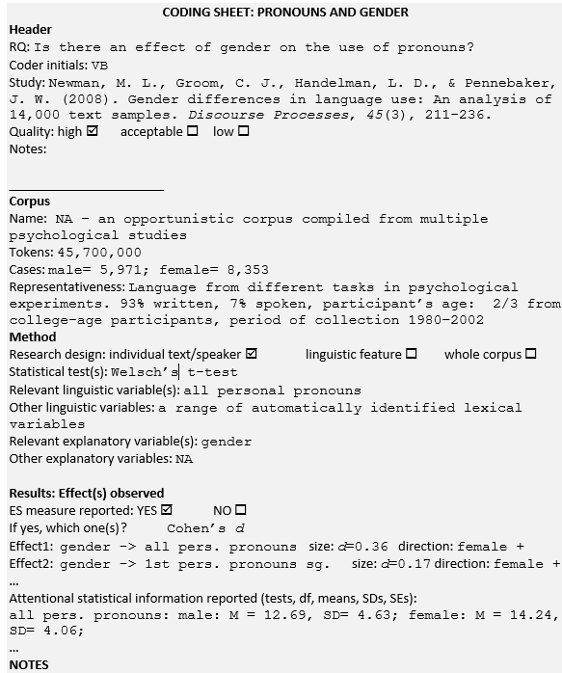
Meta-analysis step-by-step: coding

Slide 12
Meta-analysis step-by-step: statistical synthesis

Slide 13
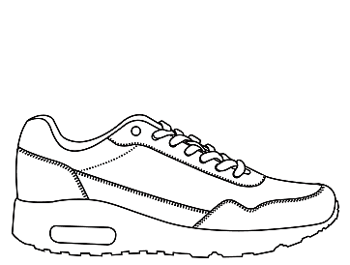
Think about and discuss
You are preparing for a half marathon and want to evaluate the effect of the training. Before the training, you run 200 meters in one minute; after the training, you run 220 yards in the same amount of time.
Did the training help?

Slide 14
Answer…
220 yards ≅ 201.2 meters > 1.2 meter improvement/minute.
Half marathon: 21,098 meters or 23,073 yards.
Overall improvement: 38 seconds.

Slide 15
Effect size measures
Effect: anything observable that is of scientific interest.
ES measures in CL: quantify the observed linguistic variables and the differences and changes in their frequencies.
Range of ES measures: can be converted to a common measure.

Slide 16
Effect size measures
Effect size
mean
% change
r
PR
MI-score, t-score, log Dice etc.
Crammer’s V
simple maths parameter, %DIFF
r²
η²
OR
Cohen’s d

Slide 17
Effect size measures (cont.)
Input | Output | Transformation/ Extrapolation
r | Cohen’s d | $$d=\frac{2r}{\sqrt{1−r^{2}}}$$
Cohen’s d | r | $$r=\frac{d}{\sqrt{d^{2}+4}}$$
η² [similar group sizes] | Cohen’s d | $$d=\frac{2×\sqrt{η^{2}}}{\sqrt{1−η^{2}}}$$
log odds ratio [ln(OR)] | Cohen’s d | $$d=\frac{ln(OR)×\sqrt{3}}{π}$$
t-test t; n₁; n₂ | Cohen’s d | $$d=t×\sqrt{\frac{n_{1}+n_{2}}{n_{1}×n_{2}}}$$
one-way ANOVA F; n₁; n₂ | Cohen’s d | $$d=±\sqrt{\frac{F(n_{1}+n_{2})}{{(n}_{1}×n_{2})}}$$

Slide 18
Effect size measures: standard interpretation
ES measure Effect | r | Cohen’s d | η² | Crammer’s V [2x2 table]
small | 0.1 | 0.3 | 0.01 | 0.1
medium | 0.3 | 0.5 | 0.06 | 0.3
large | 0.5 | 0.8 | 0.14 | 0.5

Slide 19
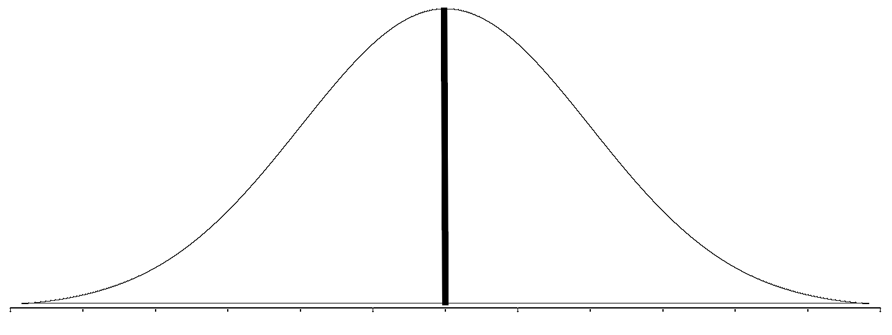
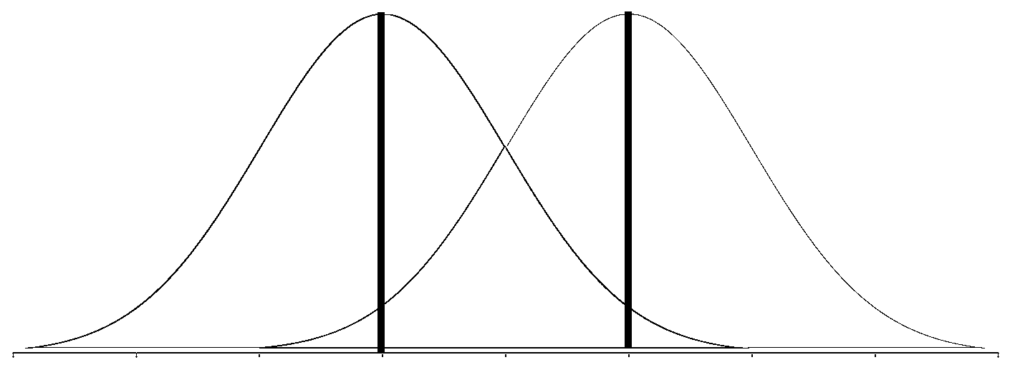
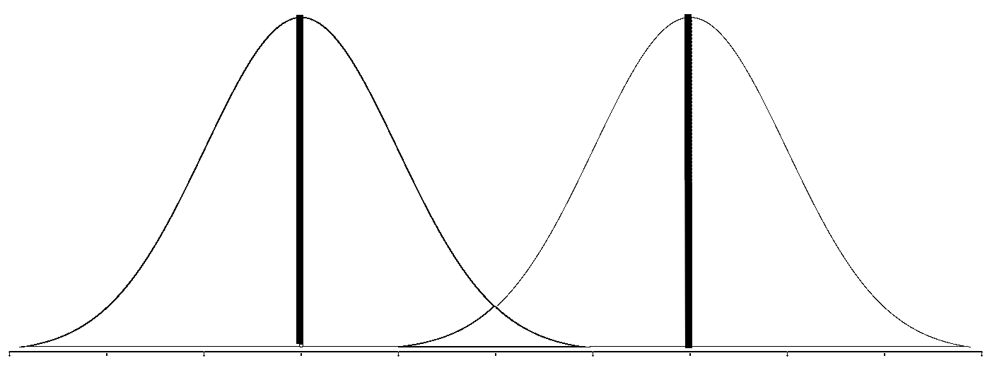
Effect size measures: CL interpretation
the in two randomly selected subcorpora of the BNC
lovely in female vs. male speech
personal pronouns in speech vs. writing
passives in academic writing vs. informal speech
0
0.7
2
2.6
3.6
4
Cohen’s d

Slide 20
Things to remember
Statistics helps us express quantitative information with precision and rigour.
Meta-analysis provides statistical summary of multiple studies by combining their effect sizes.
The results of meta-analysis can be visualised using a forest plot.
To deal with inconsistent reporting of effect sizes, we can convert one effect size measure into another or extrapolate it.
Standardised effect size measures can be understood in terms of the Probability of superiority.
Effect size measures can be interpreted with the help of benchmark points, which show examples of easily imaginable linguistic effects and the corresponding values of common effect size measures.

