Slide 1
Change over time: Working with diachronic data

Slide 2


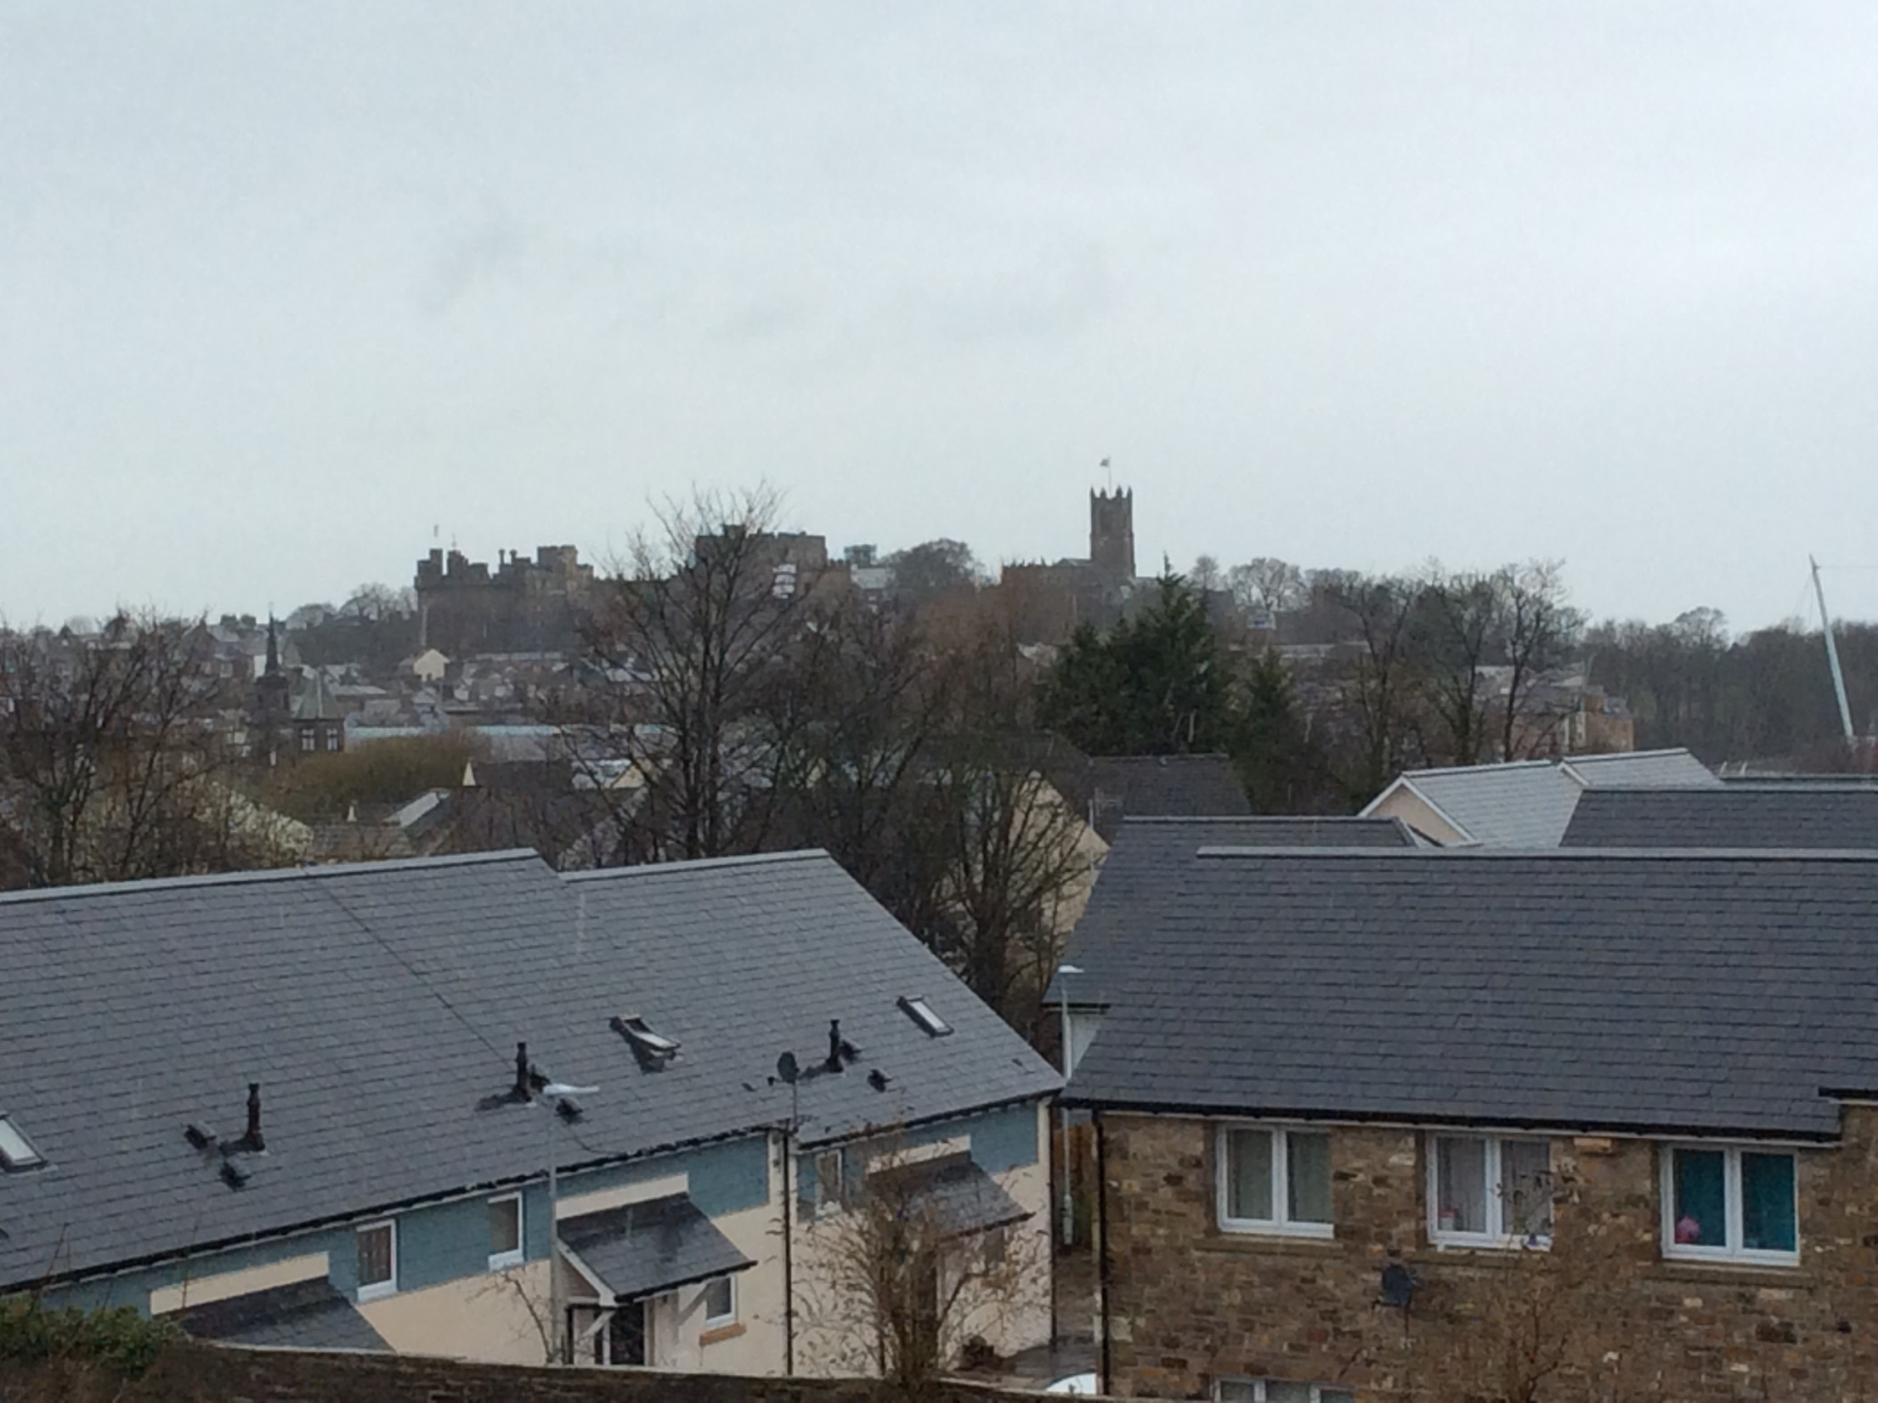

Slide 3
Think about and discuss
Which colour terms are most popular?
Does this change over time?
How would you investigate this?

Slide 4
Where to start?

Slide 5
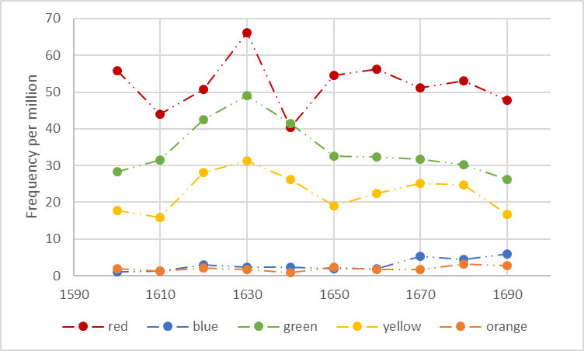
Visualising language change
Candle stick plot
Line graph
maximum value
minimum value
last value
first value
last value
first value

Slide 6
Measuring time
Time – a continuous (scale) variable; this means that we can measure time on a continuum of centuries, decades, years, months, weeks, days, hours, minutes, seconds, milliseconds etc.
Studies involving time as a variable – diachronic/longitudinal studies.
Change over time vs. stability over time.
Diachronic corpora: diachronic representativeness.
Diachronic polysemy, e.g. pre-2000s: web, tweet, cloud

Slide 7
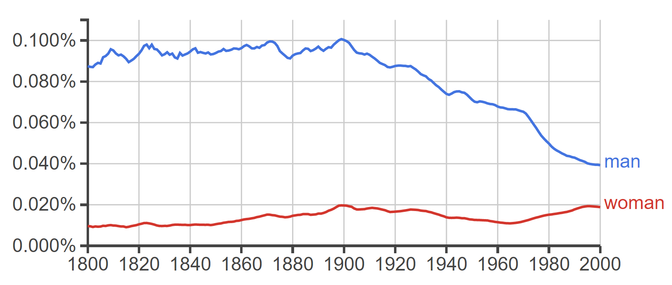
Measuring time(cont.)

Slide 8
Percentage change and bootstrap test
Linguistic feature | Corpus 1 – Commonwealth & Protectorate (1650-1659) | Corpus 2 – Restoration (1660-1669) | Percentage increase/ decrease
its | 515.86 | 652.86 | +27%
must | 1,173.02 | 1,135.67 | -3%
time(s) | 1,445.57 | 1,355.84 | -6%
pestilence | 9.88 | 13.71 | +39%
$\% increase/decrease= \frac{relative frequency in corpus 2 − relative frequency incorpus 1}{relative frequency incorpus 1}×100$
$percentage increase/decrease of its= \frac{652.86 − 515.86}{515.86}×100=26.6\%$

Slide 9

Percentage change and bootstrap test (cont.)
Bootstrapping is a process of multiple resampling, which often happens thousands of times, with replacement of the data – this means we take a random sample of texts from a corpus in such a way that each text can occur multiple times in the sample because we ‘replace’ it (i.e. place it to the pool again) once it has been taken. In each resampling cycle, we note down the value of the statistic (e.g. mean frequency of a linguistic variable) we are interested in; this gives an insight into the amount of variation in the data and gives us the confidence to generalise from this sample.

Slide 10
Bootstrap test
Corpus tests: A, B, C, D and E

Slide 11
Bootstrap test (cont.)
We compare across a large number of bootstrapping cycles the resampled corpus 1 and the resampled corpus 2 and look for a consistent difference between the resampled corpora, which would produce a low p-value (statistical significance). A low p-value is returned if in all or most cases resampled corpus 1 is either larger (we add 1 in the equation above) or smaller than corpus 2 (we add 0).

Slide 12
Neighbouring cluster analysis
hierarchical agglomerative clustering
variability-based neighbour clustering

Slide 13
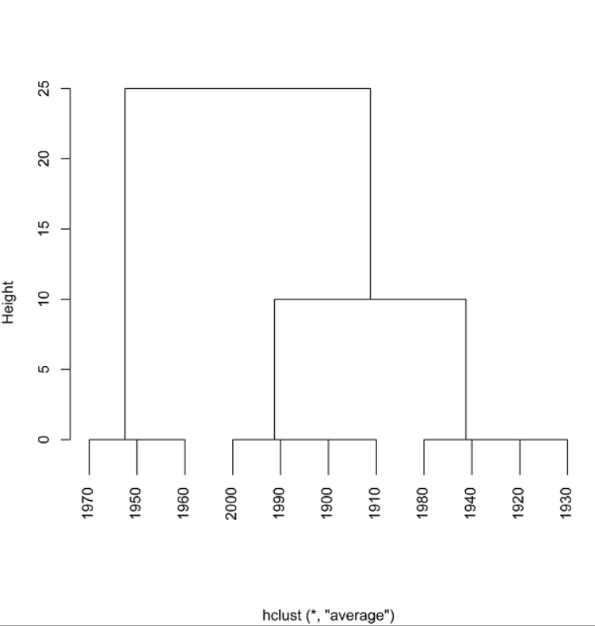
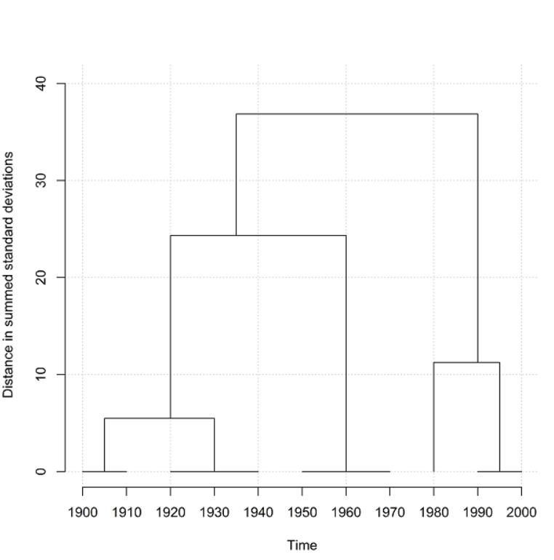
Neighbouring cluster analysis

Slide 14
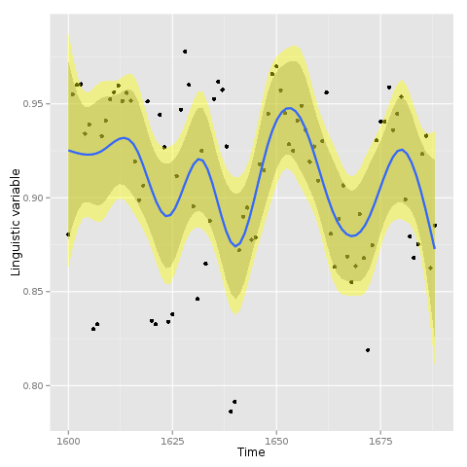
Peaks and troughs and UFA
Obligatory: Obtaining the statistic of interest for each of the periods (e.g. years, decades etc.) covered by the analysis.
Optional: Transformation of the values using binary logarithm (log2) to reduce extremes; This step is possible only if all transformed values are positive numbers because logarithm is not defined for negative numbers. Since step 2 typically produces also negative values, logarithmic transformation is possible with data from step 1.
Obligatory: Fitting a non-linear regression model (displayed as a curve in the graph), computing 95% and 99% confidence intervals (displayed as shaded areas around the curve) and identification of significant outliers – data points outside of the confidence interval area
data points across time
a non-linear regression model (GAM)
95 and 99% CI
significant outliers
Results of UFA for red 1600-1699, 3a-MI(3), L5-R5, C10relative-NC10relative; AC1

Slide 15
Things to remember
Historical analyses, because they use available and imperfect data, require critical consideration of i) diachronic representativeness of corpora, ii) alternative interpretations of linguistic development and iii) fluctuation of the meaning of linguistic forms.
Visualization options include line graphs, boxplots and error bars, sparklines and candlestick plots.
The bootstrapping test is used to compare two corpora (representing different points in time); it makes use of a technique of multiple resampling of corpus data.
Peaks and troughs is a technique which fits a non-linear regression to historical data, producing a graph which highlights significant outliers in the process of historical development of language and discourse.
UFA (Usage Fluctuation Analysis) is a complex procedure combining automatic collocation comparison in a given historical period and the peaks and troughs technique.

