Slide 1
Sociolinguistics and stylistics

Slide 2






Slide 3
Think about and discuss
Can you tell where a person is from based on their speech?
What are the features that you notice when somebody is speaking?

Slide 4
Style
“Ways of speaking that are indexically linked to social groups, times and places” Coupland (2007: 2).
Style
Individual (idiolect)
Social (sociolect)
Literary
Forensic linguistics
Sociolinguistics
Stylistics

Slide 5
Labovian sociolinguistic variable
“Different ways of saying the same thing” (Labov, 2010: 368).
Circumscribe the variable context (envelope of variation).
Lavandera (1978): Where does a sociolinguistic variable stop?
Sociolinguistic variables.

Slide 6
Labovian sociolinguistic variable (cont.)
I don't think we should go out anymore.
I don't think we should go out anymore.
no more.
competition

Slide 7
Biber’s approach
Focus on speakers’/writers’ choices “from the entire inventory of lexico-grammatical characteristics of a language, selecting the linguistic features that are best suited functionally to their situations and communicative purposes” (Biber and Conrad 2009: 265).
No clear meaning preserving competition between linguistic variants that could be easily analysed in Labovian terms.
Ambient linguistic variables.

Slide 8
Biber’s approach (cont.)
Well, you know, it you see, time were, I don't know I suppose, I don't know but I never seemed to be afraid...

Slide 9
Discuss
Can you tell the gender of Speaker 1 from the following short conversation?
Speaker 1: | So, she says, oh it don't matter. She says er <pause> will you help me fill them in now? I says, can I ask you a question? She says what? I says, these forms things, I says <pause> d'ya know how to fill them in? She says
Speaker 2: | Ah.
Speaker 1: | No.
 | She said, somebody's always done it for me.
Speaker 2: | Annette's done them.

Slide 10
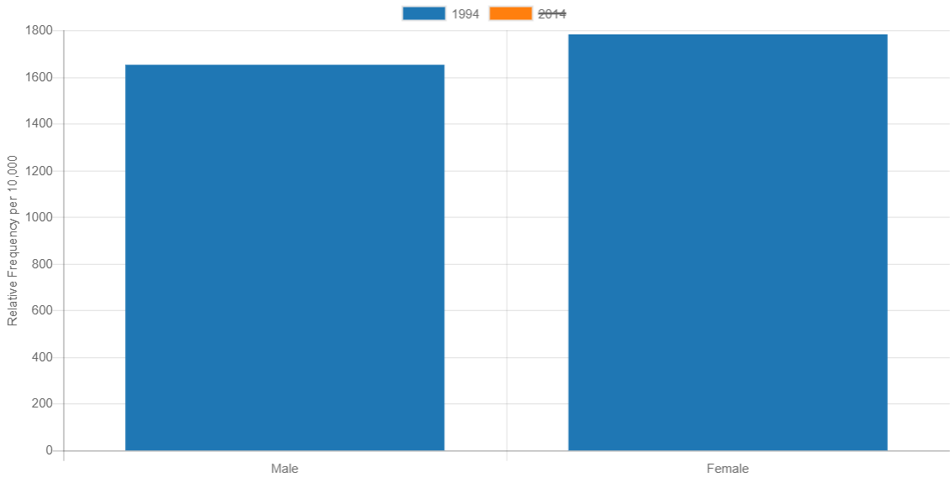
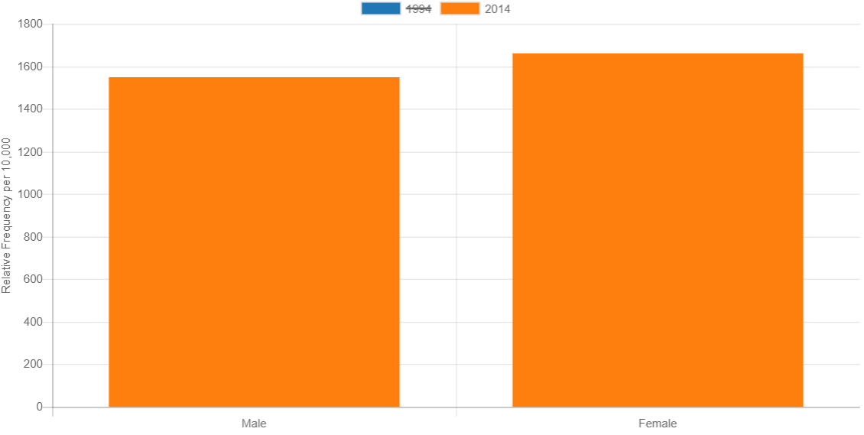
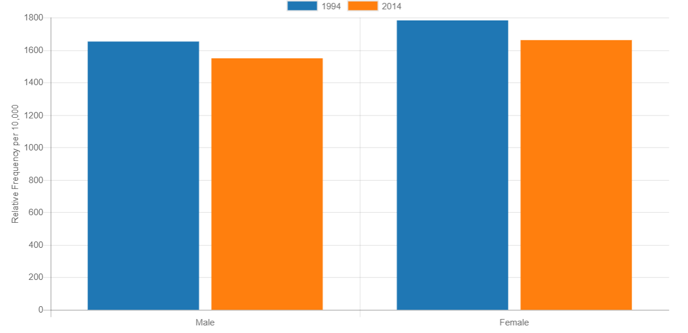

Slide 11
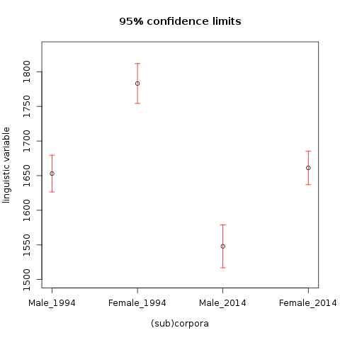

Slide 12
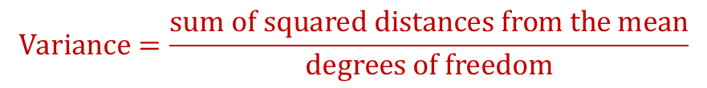
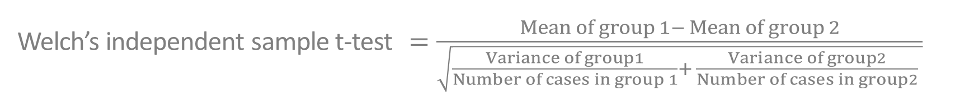

T-test
Welch’s independent sample t-test $=\frac{Mean of group 1− Mean of group 2}{\sqrt{\frac{Variance of group1}{Number of cases in group 1}+ \frac{Variance of group2}{Number of cases in group2} }}$
Welch’s independent sample t-test $=\frac{Mean of group 1− Mean of group 2}{\sqrt{\frac{Variance of group1}{Number of cases in group 1}+ \frac{Variance of group2}{Number of cases in group2} }}$
p<0.05
$$Variance=\frac{sum of squared distances from the mean}{degrees of freedom}$$
Corpus (male)
Corpus (female)
16
14

Slide 13
T-test (cont.)

Slide 14
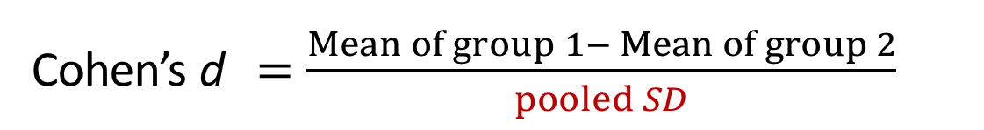
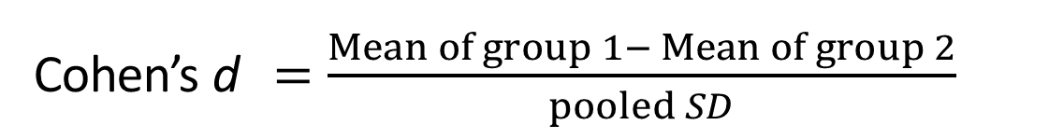
Effect size: Cohen’s d
0.3 SD apart
Cohen’s d $=\frac{Mean of group 1− Mean of group 2}{pooled SD}$
Cohen’s d $=\frac{Mean of group 1− Mean of group 2}{pooled SD}$
Corpus (male)
Corpus (female)
16
14
pooled SD = $\sqrt{\frac{{SD1}^{2}× \left(cases in group1−1\right)+ {SD2}_{ }^{2}× (cases in group2−1)}{all cases−2}}$
Interpretation of d: 0.3 small, 0.5 medium, 0.8 large effect

Slide 15
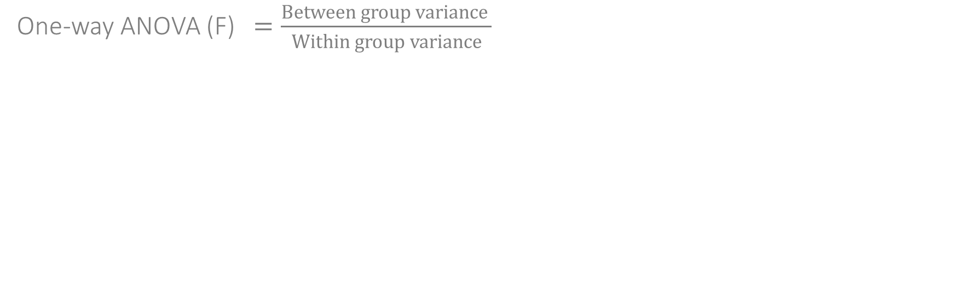
One-way ANOVA
One-way ANOVA (F) $=\frac{Between group variance }{Within group variance}$

Slide 16
One-way ANOVA
One-way ANOVA (F) $=\frac{Between group variance }{Within group variance}$

Slide 17
One-way ANOVA
One-way ANOVA (F) $=\frac{Between group variance }{Within group variance}$

Slide 18
Tests: overview
Test | T-test | ANOVA | Mann-Whitney U | Kruskal-Wallis
No. of groups compared | 2 | 2+ | 2 | 2+
Assumes underlying normal distribution of the linguistic variable in the population | YES | YES | NO | NO
Assumes independence of texts/speakers | YES | YES | YES | YES
Allows testing interaction between different explanatory variables (e.g. register and author’s gender) | NO | YES | NO | NO

Slide 19
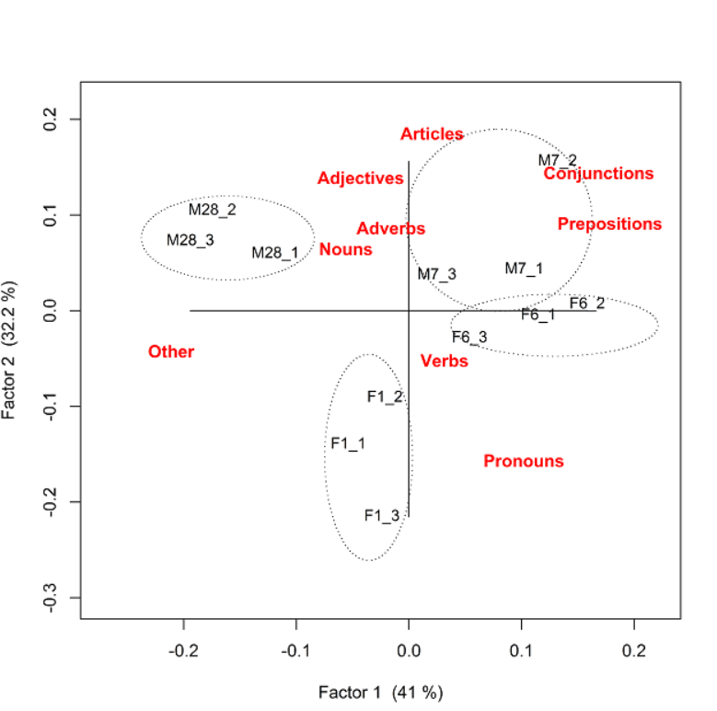
Correspondence analysis
Sample | Verbs | Nouns | Pronouns | Adjectives | Adverbs | Prepositions | Conjunctions | Articles | Other word classes
F1_1 | 257 | 154 | 197 | 42 | 81 | 39 | 26 | 39 | 165
F1_2 | 240 | 139 | 182 | 19 | 82 | 65 | 42 | 49 | 182
F1_3 | 267 | 101 | 208 | 30 | 83 | 53 | 39 | 26 | 193
F6_1 | 256 | 109 | 179 | 29 | 103 | 61 | 69 | 61 | 133
F6_2 | 257 | 115 | 181 | 48 | 79 | 78 | 68 | 54 | 120
F6_3 | 257 | 152 | 171 | 23 | 97 | 64 | 49 | 49 | 138
M7_1 | 250 | 121 | 163 | 31 | 134 | 68 | 57 | 55 | 121
M7_2 | 218 | 161 | 148 | 47 | 92 | 87 | 70 | 67 | 110
M7_3 | 248 | 130 | 151 | 47 | 107 | 76 | 41 | 53 | 147
M28_1 | 235 | 154 | 124 | 41 | 108 | 48 | 52 | 49 | 189
M28_2 | 219 | 154 | 106 | 42 | 114 | 57 | 42 | 58 | 208
M28_3 | 219 | 141 | 120 | 48 | 100 | 40 | 47 | 66 | 219

Slide 20
Correspondence analysis
Sample | Verbs | Nouns | Pronouns | Adjectives | Adverbs | Prepositions | Conjunctions | Articles | Other word classes
F1_1 | 257 | 154 | 197 | 42 | 81 | 39 | 26 | 39 | 165
F1_2 | 240 | 139 | 182 | 19 | 82 | 65 | 42 | 49 | 182
F1_3 | 267 | 101 | 208 | 30 | 83 | 53 | 39 | 26 | 193
F6_1 | 256 | 109 | 179 | 29 | 103 | 61 | 69 | 61 | 133
F6_2 | 257 | 115 | 181 | 48 | 79 | 78 | 68 | 54 | 120
F6_3 | 257 | 152 | 171 | 23 | 97 | 64 | 49 | 49 | 138
M7_1 | 250 | 121 | 163 | 31 | 134 | 68 | 57 | 55 | 121
M7_2 | 218 | 161 | 148 | 47 | 92 | 87 | 70 | 67 | 110
M7_3 | 248 | 130 | 151 | 47 | 107 | 76 | 41 | 53 | 147
M28_1 | 235 | 154 | 124 | 41 | 108 | 48 | 52 | 49 | 189
M28_2 | 219 | 154 | 106 | 42 | 114 | 57 | 42 | 58 | 208
M28_3 | 219 | 141 | 120 | 48 | 100 | 40 | 47 | 66 | 219

Slide 21
Discuss
Which of these sentences sound more natural to you?
…was Frodo Baggins trying to steal from a farmer’s field when he got into trouble as a young Hobbit…
…was Frodo Baggins trying to steal from a field of a farmer when he got into trouble as a young Hobbit…
possessor
possessum
possessum
possessor

Slide 22
Sociolinguistic study of English possessives
Research with Miriam Meyerhoff, Susan Reichelt and Dana Gablasova.
Constraints: external and internal for the use of possessive ’s vs. of.
Semi-automatic + manual coding of 5,011 target variables, of which 2,219 are of and 2,792 are ’s.

Slide 23
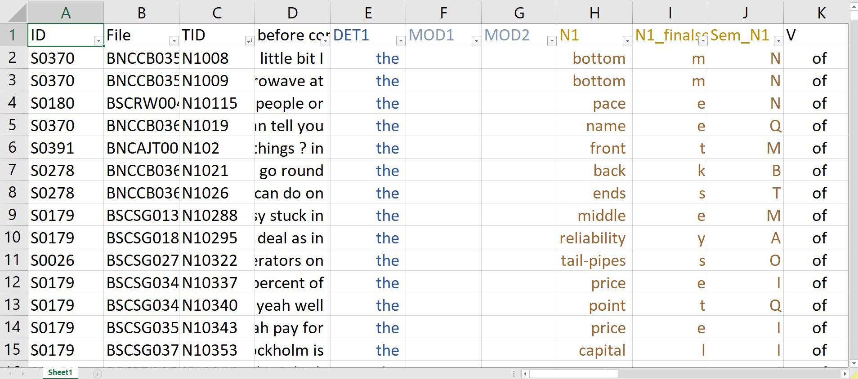

Slide 24
Results
Peter’s friend
the roof of a house

Slide 25
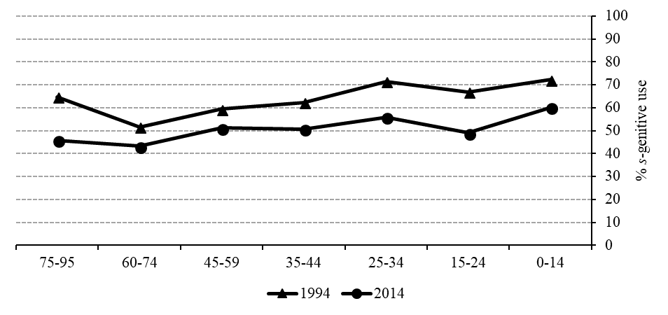
Results
But: 1994 BNC subset consists of 59% (human) animate possessor contexts, while the 2014 data consists of only 41% (human) animate possessor contexts.

Slide 26
s-genitive clearly favours animate contexts, of which the typical possessive construction of ownership and kinship is part.
As expected, sibilants disfavour the s-genitive.
Effect of gender in 1994 (female preference).
2014: more blurred distinction between ’s and of.

Slide 27
Things to remember
Sociolinguistic variation can be operationalised in different ways: Labovian meaning-preserving sociolinguistic variable (formal approach), or the functional approach looking at the distribution of linguistic features in groups of speakers.
The t-test, ANOVA (as well as their non-parametric counterparts: Mann-Whitney U and Kruskal-Wallis) are used to investigate the effect of explanatory social variables (gender, social class) on the use of different linguistic features.
Correspondence analysis is an exploratory analytical technique, which compares the use of multiple variables in different speakers reducing them to two factors and producing a powerful visualisation – a correspondence plot.
Mixed-effects models is a group of sophisticated statistical techniques, which can account for multiple variables at the same time and include the effect of individual variation between speakers.

