Slide 1
Register variation: correlation, clusters and factors

Slide 2

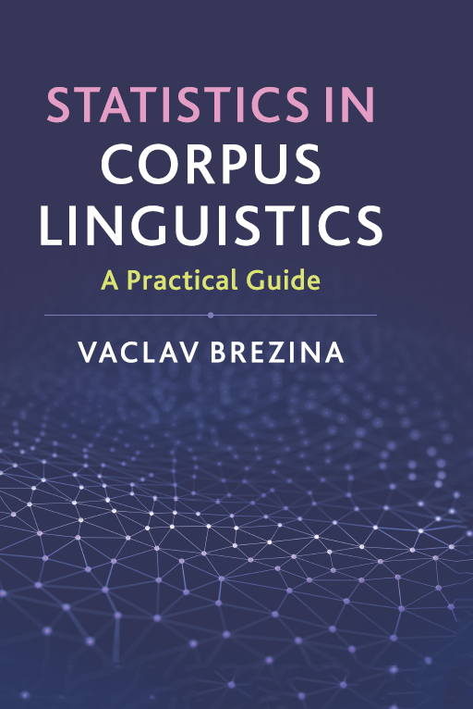

Slide 3
Think about and discuss
Think about how language works.
Is it more surprising to find that some linguistic features are related or that they are unrelated?

Slide 4
Where to start?

Slide 5
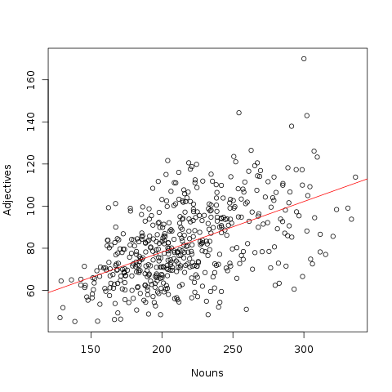
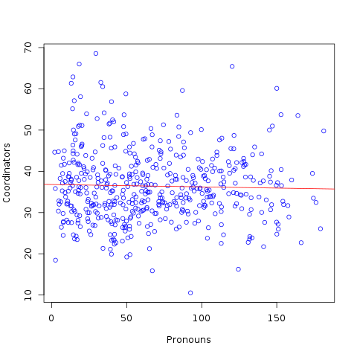
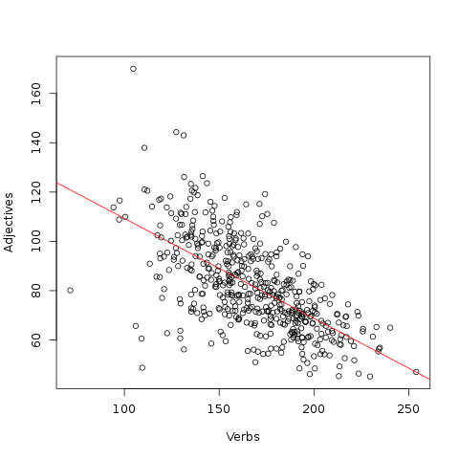
Relationships in corpora
+
-
~

Slide 6
Co-variance
SD = measure of variation of a single variable in a corpus.
Co-variance = measure of co-variation of two variables.

Slide 7
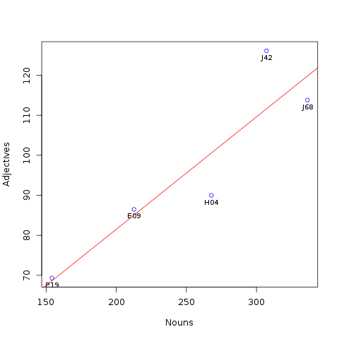
Co-variance (cont.)

Slide 8
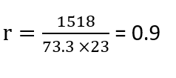
Correlation
Correlation = standardised co-variance.
0 no effect
± 0.1 small effect
± 0.3 medium effect
± 0.5 large effect
0 no effect
± 0.1 small effect
± 0.3 medium effect
± 0.5 large effect
p = 0.033

Slide 9
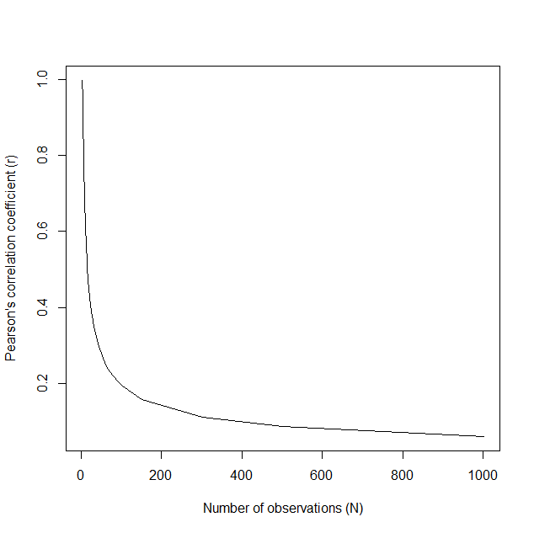
Correlation as effect size and significance test
0 no effect
± 0.1 small effect
± 0.3 medium effect
± 0.5 large effect

Slide 10
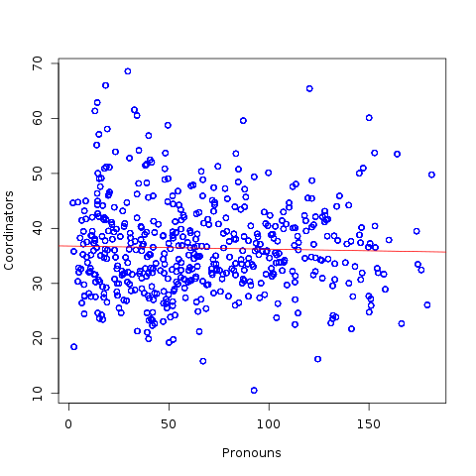
500 vs. 5000
NON-SIGNIFICANT
r = -.029; p = .52; 95% CI [-.116,.059]
SIGNIFICANT
r = -.029; p = .04; 95% CI [-.057, -.001]

Slide 11
Pearson’s and Spearman’s correlations
Pearson’s correlation: r
Spearman’s correlation: r_{s,} rho, ρ

Slide 12
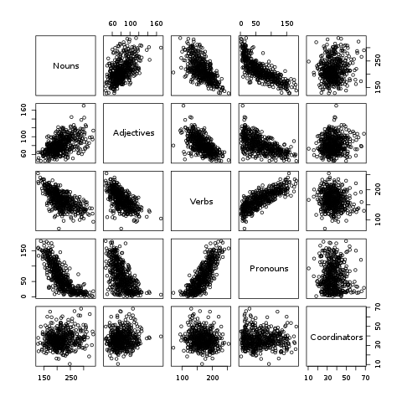
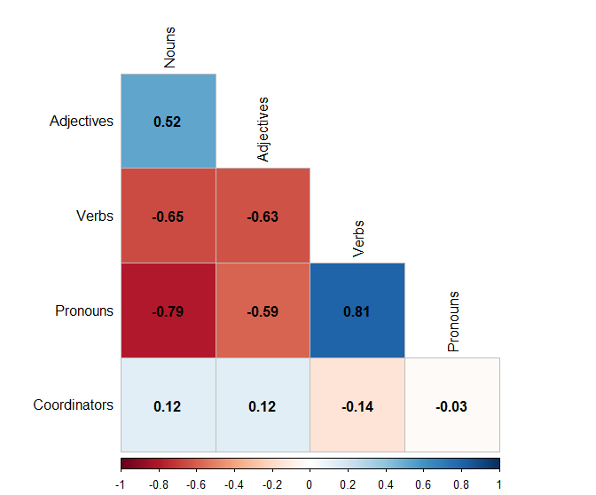
Visualizing correlation

Slide 13
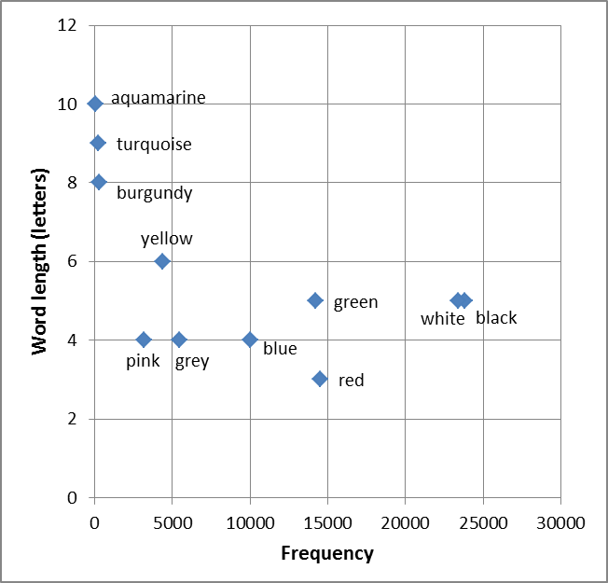
Hierarchical agglomerative cluster analysis
hierarchical tree plot (or dendrogram)

Slide 14

Cluster analysis: Distance
B
A
B
A

Slide 15
Cluster analysis: Linking
Q: Which of the data points inside a small cluster should be taken as representing the position of the whole cluster?
The closest point to the neighbouring cluster with which we want to merge our original cluster (so called SLINK method)
The furthest point to the neighbouring cluster with which we want to merge our original cluster (so-called CLINK method)
None, the mutual distances of all data points are considered by taking their mean value (average linkage method)
None, mutual distances of all data points are considered by calculating the sum of squared distances (Ward’s method).

Slide 16
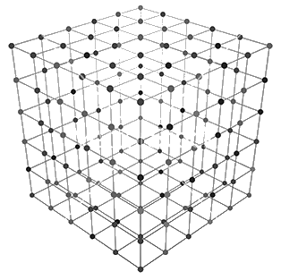
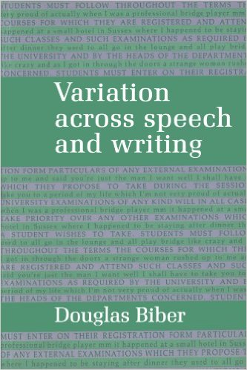
passives
…
nouns
verbs
pronouns
past tense
modality
negation

Slide 17
67 Biber variables

Slide 18
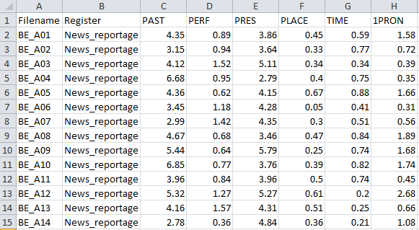
Data
Individual text design

Slide 19
Factor analysis
Complex mathematical procedure that reduces a large number of linguistic variables to a small number of factors, each combining multiple linguistic variables. This is done by considering correlations between variables; those that correlate – both positively and negatively – are considered components of the same factor because they have a connection.

Slide 20
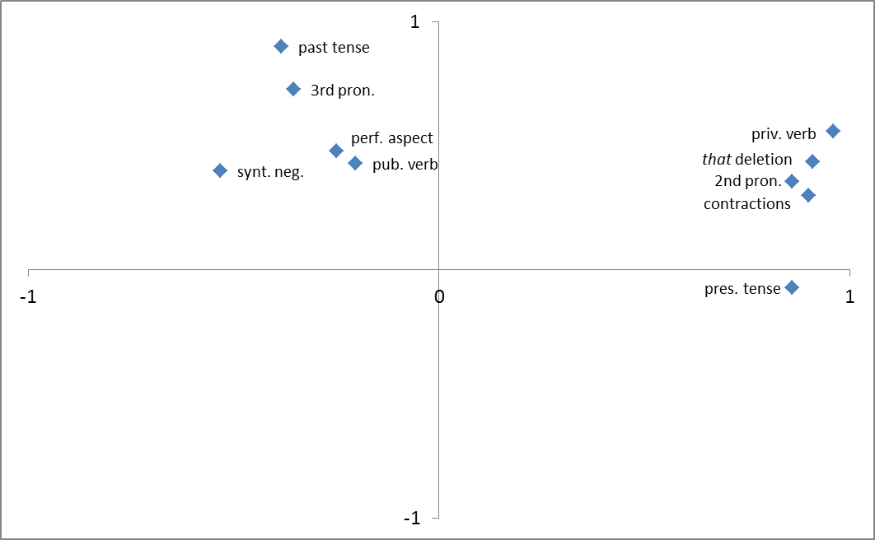
Factors
Factor 2
Factor 1

Slide 21
Factors (cont.)

Slide 22
Factors > Dimensions
INVOLVED
INFORMATIONAL

Slide 23
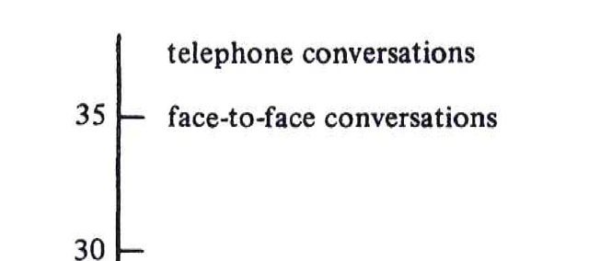
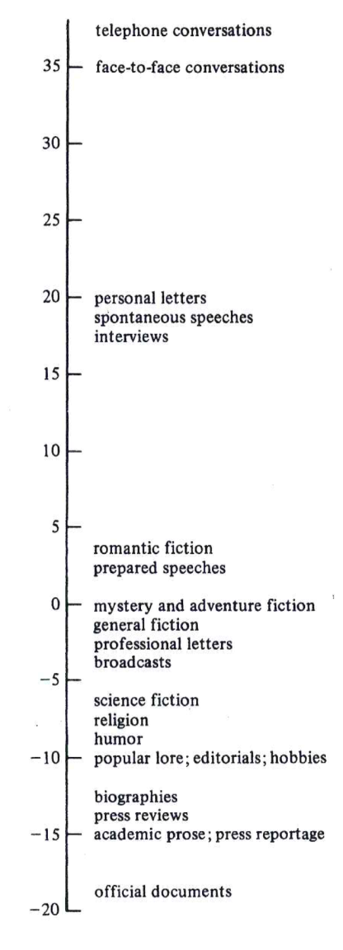
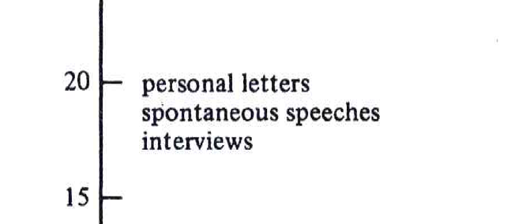
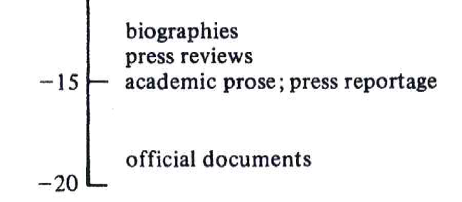
Placement of registers
INVOLVED
INFORMATIONAL

Slide 24
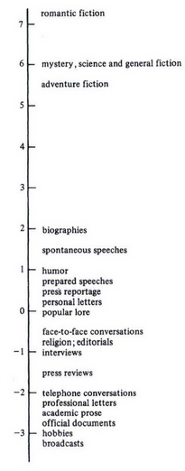
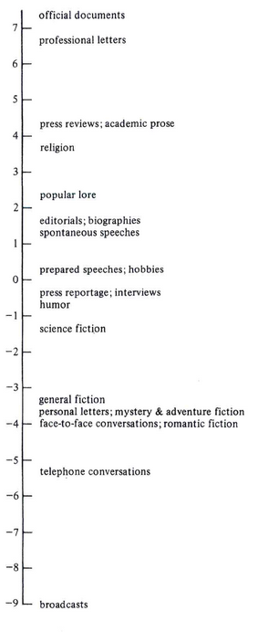
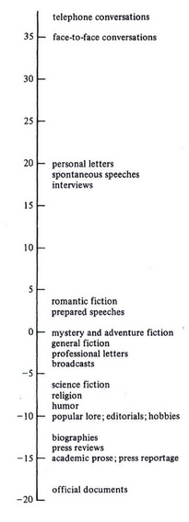

Slide 25
Things to remember
Correlations are used for the investigation of the relationship between two variables at a time.
Pearson’s correlation is suitable for scale variables, while Spearman’s correlation assumes ordinal variables (ranks). Spearman’s correlation can also be used with scale variables if the means as the measures of central tendency do not represent the data well (extremely skewed distributions).
Hierarchical agglomerative cluster analysis is used for classification of words, texts, registers etc. The result of this analysis is a tree plot (dendrogram).
The most complex type of analysis out of the three discussed in this chapter is multidimensional analysis (MD). MD analyses a large number of linguistics variables and reduces them to a small number of factors which are interpreted as dimensions of variation. Along these dimensions, different registers can be placed.

