Slide 1
Lexico-grammar: From simple counts to complex models

Slide 2
“If these words are not essential to the meaning of your sentence, use ‘which’ and separate the words with a comma” (Microsoft 2010).

Slide 3
Think about and discuss
What is a grammatical rule?
Do you think grammatical rules apply in all cases?

Slide 4
Where to start?

Slide 5
Lexico-grammar: Research design
Linguistic feature design
explanatory variables/predictors
Linguistic/outcome variable

Slide 6
Lexico-grammatical frame
Opportunity of use (obligatory place).
Place where variation happens in text.
E.g.
NOUN + which/that + relative clause

Slide 7
Lexico-grammatical frame (cont.)
Research question | Outcome variable options | Lexico-grammatical frame
When do we use the passive construction? | ACTIVE, PASSIVE | All verb forms that can be used in passive i.e. transitive verbs.
In what contexts do we use which and in what contexts that in relative clauses? | which, that | All relative clauses.
When do speakers use that deletion? E.g. I think Ø this is good. | that, Ø [no relativizer] | All clauses where that occurs or is deleted.
What is the difference between various modal expressions of strong obligation? | must, have to, need to | All contexts in which strong deontic modals occur.

Slide 8
Lexico-grammatical vs. ‘ambient’ variables
It's about time that was done [BNC, file: KBB].
Well, you know, it you see, time were, I don't know I suppose, I don't know but I never seemed to be afraid... [BNC, file: HDK].

Slide 9
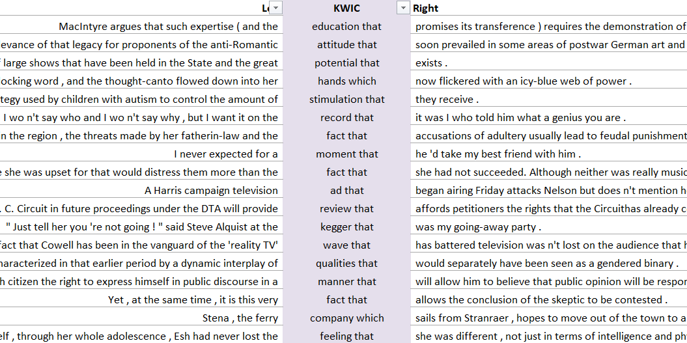
Cross-tabulation and mosaic plot
Presence of separator Relativizer | separator (, or –) | no separator | Total
which | 1,396 (63%) | 804 (37%) | 2,200
that | 191 (3%) | 7,281 (97%) | 7,472
Total | 1,587 | 8,085 | 9,672

Slide 10
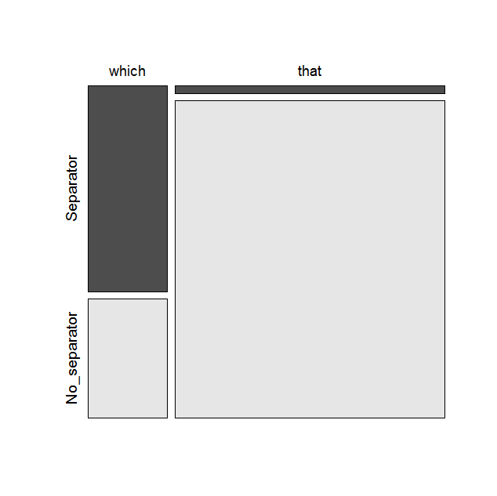
Cross-tabulation and mosaic plot (cont.)
Presence of separator Relativizer | separator (, or –) | no separator | Total
which | 1,396 (63%) | 804 (37%) | 2,200
that | 191 (3%) | 7,281 (97%) | 7,472
Total | 1,587 | 8,085 | 9,672

Slide 11
Percentages and chi-squared test
Percentages in a cross-tabulation table $=\frac{cell value}{relevant total} ×100$
Chi-squared $=Sum for all cells of \frac{{(observed frequency −expected frequency)}^{2}}{expected frequency}$
Assumptions:
Independence of observations.
Expected frequencies greater than 5 (In contingency tables larger than 2 × 2 at least 80% of expected frequencies greater than 5).
Alternative tests: Log likelihood test (also known as likelihood ratio test or G test) or the Fisher exact test.

Slide 12
Complex model: logistic regression
Variety | Separator (, or –) | Clause | Syntax | Relativizer |  | Total
 |  |  |  | that | which
American | NO | Non-restrictive | Object | 3 | 1 | 4
 |  |  | Subject | 11 | 2 | 13
 |  | Restrictive | Object | 18 | 2 | 20
 |  |  | Subject | 126 | 5 | 131
 | YES | Non-restrictive | Object | 0 | 6 | 6
 |  |  | Subject | 0 | 20 | 20
 |  | Restrictive | Object | 0 | 0 | 0
 |  |  | Subject | 1 | 0 | 1
British | NO | Non-restrictive | Object | 3 | 2 | 5
 |  |  | Subject | 3 | 8 | 11
 |  | Restrictive | Object | 14 | 8 | 22
 |  |  | Subject | 76 | 15 | 91
 | YES | Non-restrictive | Object | 0 | 4 | 4
 |  |  | Subject | 0 | 31 | 31
 |  | Restrictive | Object | 1 | 0 | 1
 |  |  | Subject | 0 | 0 | 0
Total |  |  |  | 256 | 104 | 360
Presence of separator Relativizer | separator (, or –) | no separator | Total
which | 1,396 (63%) | 804 (37%) | 2,200
that | 191 (3%) | 7,281 (97%) | 7,472
Total | 1,587 | 8,085 | 9,672

Slide 13
Logistic regression
Outcome: nominal, (ordinal)
Statistical model:
Combination of predictors with different weights,
linguistically: patterns/'rules' of lexico-grammar
Category A
e.g. that
Category B
e.g. which
[...]
Predictors: nominal, ordinal, scale

Slide 14
Logistic regression: Dataset
explanatory variables/predictors
Linguistic/outcome variable
nominal
nominal
nominal
scale
nominal
nominal

Slide 15
Logistic regression: output
Model 1 with predictor variables (‘Variety’, ‘Separator’, ‘Clause type’, ‘Syntax’ and ‘Length’) is significant (LL: 222.31; p < .0001) and has outstanding classification properties (C-index: 0.91).
 | Estimate (log odds) | Standard Error | Z value (Wald) | p-value | Estimate (odds) | 95% CI lower | 95% CI upper
(Intercept) | -3.354 | 0.563 | -5.958 | 0.000 | 0.035 | 0.011 | 0.099
VarietyB_BR | 1.667 | 0.397 | 4.195 | 0.000 | 5.296 | 2.511 | 12.080
SeparatorB_YES | 3.985 | 0.825 | 4.832 | 0.000 | 53.795 | 12.876 | 376.448
ClauseB_Non_restr | 2.046 | 0.446 | 4.588 | 0.000 | 7.733 | 3.235 | 18.812
SyntaxB_Subject | -0.614 | 0.421 | -1.460 | 0.144 | 0.541 | 0.240 | 1.260
Length | 0.079 | 0.029 | 2.739 | 0.006 | 1.083 | 1.023 | 1.147

Slide 16
“If these words are not essential to the meaning of your sentence, use ‘which’ and separate the words with a comma” (Microsoft 2010).
Was the computer right after all? If the suggestion by the computer were to be taken as a categorical rule, the answer is certainly ‘no’. There is a combination of multiple factors that favour or disfavour the use of which (and that) and these factors have to be interpreted as probabilities (or odds, to be precise), not certainty.

Slide 17
Things to remember
When analysing lexico-grammatical variation we need to pay attention to individual linguistic contexts and define a lexico-grammatical frame.
Cross-tabulation can be used for a simple analysis of categorical variables. In addition to frequencies, crosstab tables can also include percentages based on row totals (most useful for investigation of lexico-grammar), column totals and the grand total.
The data in cross-tab tables can be effectively visualized using mosaic plots.
We can test the statistical significance of the relationship between variables in a two-way crosstab table (i.e. a table with one linguistic and one explanatory variable) using the chi-squared test. The effect sizes reported are Cramer’s V (overall effect) and probability or odds ratios (individual effects).
Logistic regression is a sophisticated multivariable method for analysing the effect of different predictors (both categorical and scale) on a categorical (typically binary) outcome variable.

