Slide 1
Semantics and discourse: Collocations, keywords and reliability of manual coding

Slide 2
Statistical analysis of discourse involves an inherent paradox. While discourse is often fluid, ambiguous and fuzzy, statistics expects rigour, precision and clearly defined categories.

Slide 3
Think about and discuss
What associations come to your mind when you see the word love?
Why do you think the word has these associations for you?

Slide 4
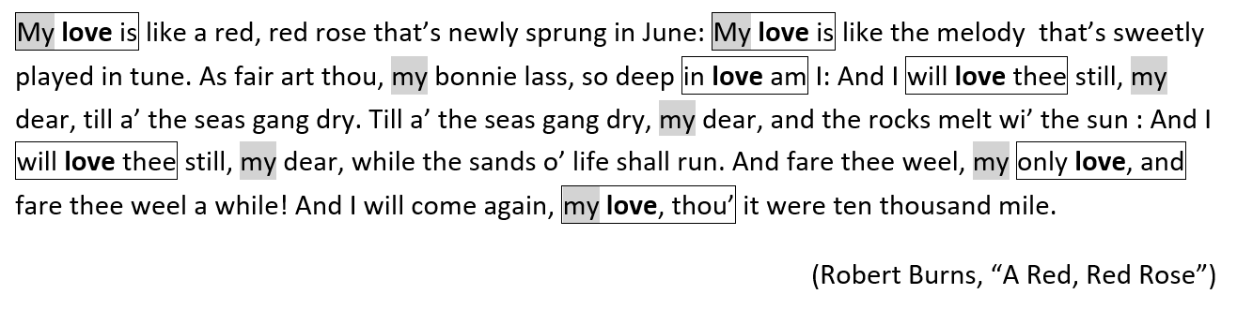
Collocations
node
collocates
collocation window (span): 1L 1R

Slide 5
Collocations (cont.)
Is my really a genuine collocate of love in the poem?
In other words, is my really strongly associated with love?
Observed frequency (3) compared with:
No baseline: We compare the observed frequencies of all individual words co-occurring with the node and produce a rank-ordered list.
Random co-occurrence baseline (‘shake the box’ model): We compare the observed frequencies with frequencies expected by chance alone and evaluate the strength of collocation using a mathematical equation which puts emphasis on a particular aspect of the collocational relationship.
Word competition baseline: We use a different type of baseline from random co-occurrence; this baseline is incorporated in the equation, which again highlights a particular aspect of the collocational relationship.

Slide 6
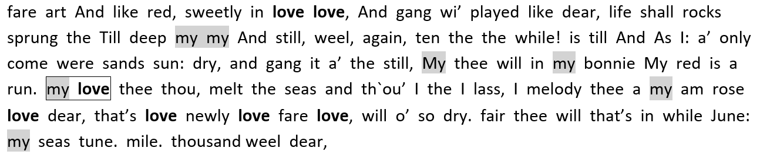
‘Shake the box’ model

Slide 7

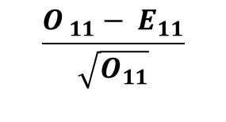

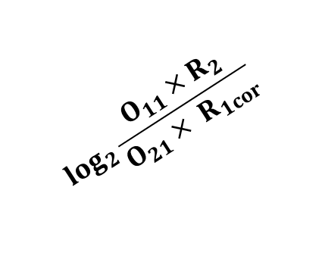
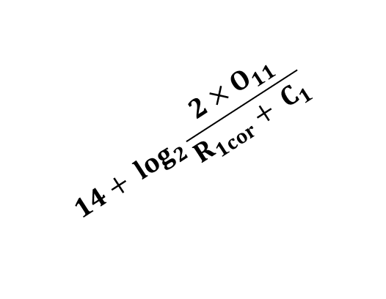


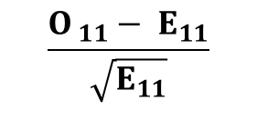

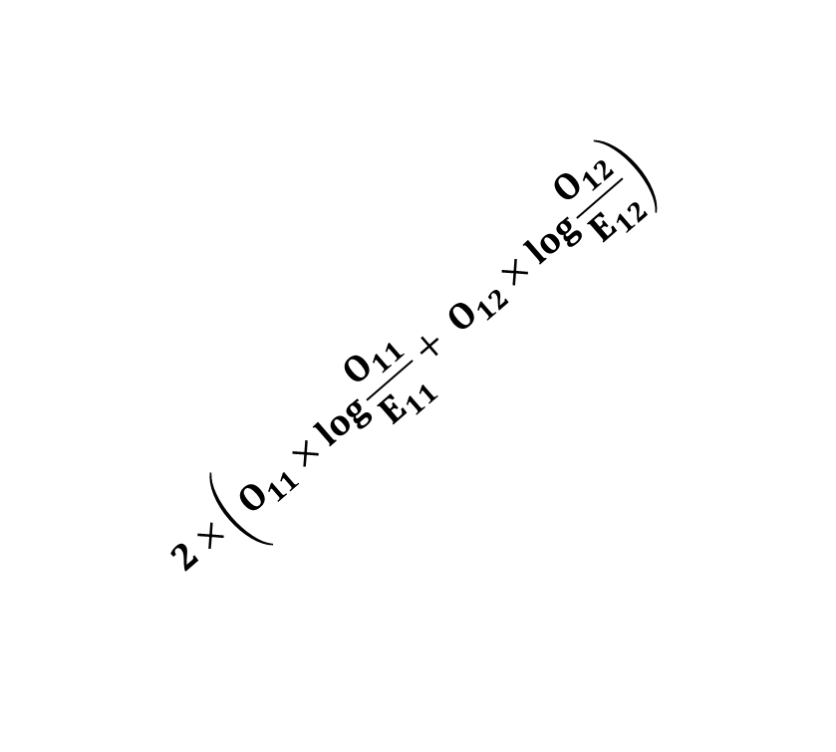

Association measures
$$\frac{O_{ 11}− E_{11}}{\sqrt{E_{11}}}$$
$$\log_{2}{\frac{{O_{11}}^{3}}{E_{11}}}$$
$$\log_{2}{\frac{{O_{11}}^{2}}{E_{11}}}$$
$$2×\left(O_{11}×log\frac{O_{11}}{E_{11}}+ O_{12}×log\frac{O_{12}}{E_{12}}\right)$$
$$\frac{M_{in window}−M_{outside window}}{pooled SD}$$
$$\log_{2}{\frac{O_{11}×R_{2}}{O_{21}× R_{1cor}}}$$
$$\frac{{2×O}_{11}}{R_{1}+ C_{1}}$$
$$\frac{O_{ 11}− E_{11}}{\sqrt{O_{11}}}$$
T score
MI2
MI3
log likelihood
z score
log Dice
Delta P
Dice
$$\frac{O_{11}}{R_{1}}−\frac{O_{21}}{R_{2}}$$
log ratio
Cohen’s d
$$14+ \log_{2}\frac{{2×O}_{11}}{R_{1cor}+ C_{1}}$$

Slide 8

Association measures (cont.)

Slide 9
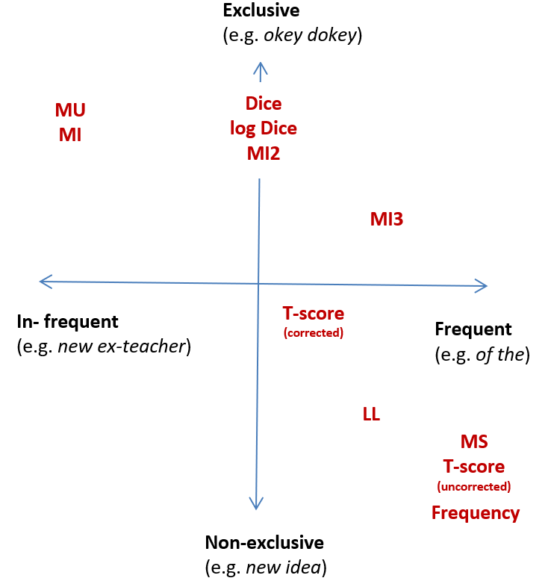
Association measures (cont.)

Slide 10
Collocation networks
C2
C3
N4
C1
C2
C3
C2
N3
C1
C1
C2
C1
N2
node
C3
C5
C4

Slide 11
CPN (Brezina et al. 2015)

Slide 12
Keywords
Positive keywords +
Lockwords
Negative keywords -
100M
Corpus of interest C | Reference corpus R | Decision
frequent | infrequent | + (positive keyword)
infrequent | frequent | - (negative keyword)
comparable freq. | comparable freq. | 0 (lockword)
1M
Corpus of interest
Reference corpus

Slide 13
Keywords (cont.)
Log likelihood | SMP (with 100 as the constant) | Log ratio | Cohen’s d
U.S. | U.S. | LABOR | TOWARD
PERCENT | PERCENT | NEIGHBORHOOD | NEIGHBORHOOD
AMERICAN | PROGRAM | DEFENSE | RECOGNIZE
PROGRAM | TOWARD | CONGRESSIONAL | NEIGHBORS
TOWARD | AMERICAN | ATLANTA | COLORED
STATES | BUSH | PGF2A | MANHATTAN
FEDERAL | FEDERAL | MACDOWELL | FAVORITE
BUSH | STATES | MRNA | RECOGNIZED
PRESIDENT | CENTER | NEIGHBORS | CENTER
CENTER | MR. | ABBY | REALIZE
MR. | PRESIDENT | GENOME | RECOGNIZING
PROGRAMS | PROGRAMS | FLORIDA | TRAVELED
UNITED | UNITED | 9-11 | SIGNALED
STATE | WASHINGTON | DOE | COLOR
CONGRESS | CONGRESS | POE | CALIFORNIA
WASHINGTON | AMERICANS | ROUSSEAU | GOTTEN
AMERICANS | STATE | NS1 | LABOR
DEFENSE | CALIFORNIA | REZKO | FAVOR
CALIFORNIA | AMERICA | MITCH | FINALLY
WAR | DEFENSE | ADDITIVES | CENTERS

Slide 14
Inter-rater agreement
Inter-rater agreement, which is an estimate of how reliable and consistent a coding is, should be reported in studies working with a judgement variable.
Judgement variable is a variable that involves categorisation or evaluation of cases (e.g. concordance lines) by the analyst that might bring an element of subjectivity into the study.

Slide 15
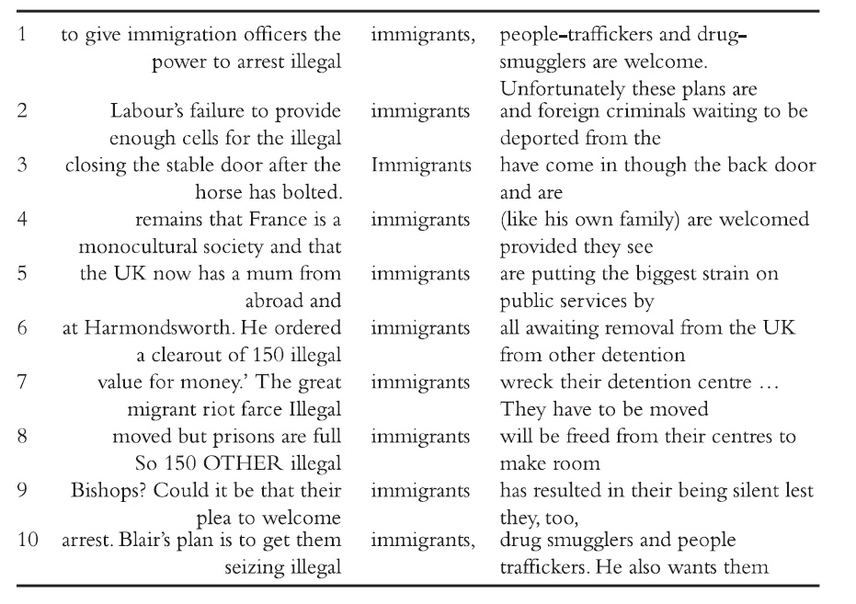
Inter-rater agreement (cont.)
Positive or Negative?
Categorisation is a matter of choice.
Rigorous?

Slide 16
Inter-rater agreement (cont.)
Rater 1
negative
negative
negative
positive
negative
negative
negative
negative
positive
negative

Slide 17
Inter-rater agreement (cont.)
Rater 1 | Rater 2
negative | negative
negative | negative
negative | negative
positive | positive
negative | positive
negative | negative
negative | negative
negative | negative
positive | negative
negative | negative

Slide 18
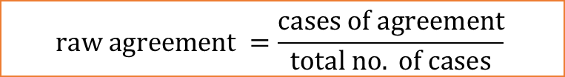

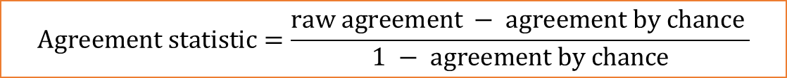
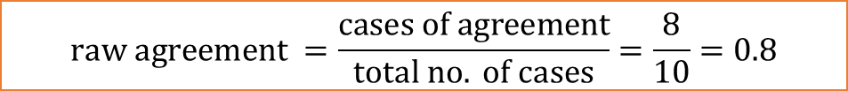
Inter-rater agreement (cont.)
$$raw agreement =\frac{cases of agreement}{total no. of cases}=\frac{8}{10}=0.8$$
Rater 1 | Rater 2
negative | negative | YES
negative | negative | YES
negative | negative | YES
positive | positive | YES
negative | positive | NO
negative | negative | YES
negative | negative | YES
negative | negative | YES
positive | negative | NO
negative | negative | YES
$$raw agreement =\frac{cases of agreement}{total no. of cases}$$
$$Agreement statistic=\frac{raw agreement − agreement by chance }{1 − agreement by chance}$$
${AC}_{1}=\frac{0.8 − 0.32 }{1 − 0.32}$ = 0.71

Slide 19

$${Cohen’s κ/AC}_{1}$$
0.71

Slide 20
Inter-rater agreement (cont.)
Type of judgement variable | No. of values | No. of raters | Statistic(s) to use
Nominal (categories) | 2 and more | 2 | Gwet’s AC₁ and Cohen’s κ
 | 2 and more | 3 and more | Gwet’s AC₁ and Fleiss' κ
Ordinal (ranks) | 2 and more | 2 and more | Gwet’s AC₂
Interval/Ratio (scale) | 2 and more | 2 and more | Interclass correlation (ICC)

Slide 21
Things to remember
There are many association measures each highlighting different aspects of the collocational relationship (e.g. frequency or exclusivity). There is no one best association measure.
Collocations can be presented in a tabular (table) or visual form (graph).
Collocation networks show complex cross-associations in texts and discourses.
The keyword procedure in its essence is a comparison which depends on a number of parameters. There is no such thing as one set of keywords.
For judgement variables inter-rater agreement statistic should be reported. Gwet’s AC1 and AC2, Cohen’s κ and Fleiss' κ as well as Interclass correlation can be used depending on the situation.

