Slide 1
Vocabulary: Frequency, dispersion and diversity

Slide 2
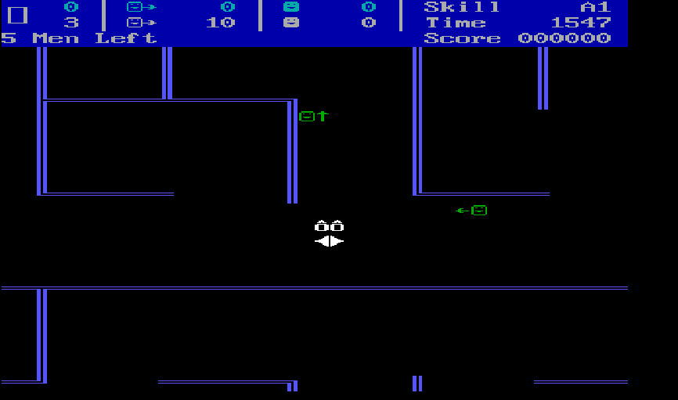
*
*
*
O
O
O
“You simply cannot kill him before he kills you, if you rush.”
Snipes (1982)

Slide 3
Think about and discuss
How would you define a word?
How many words do the following two sentences consist of?
“You simply cannot kill him before he kills you, if you rush.”
12 tokens, 10 types, 9 lemmas

Slide 4
Tokens, types, lemmas and lexemes
You¹|simply²| cannot³| kill⁴|him ⁵|before⁶| he⁷| kills⁸| you⁹| if ¹⁰|you¹¹| rush¹²|
You¹|simply²| cannot³| kill⁴|him ⁵|before⁶| he⁷| kills⁸| if ⁹|rush¹⁰|
YOU¹|SIMPLY²| CAN³| NOT⁴| KILL⁵|HE⁶| BEFORE⁷| IF ⁸|RUSH⁹
tokens
types
lemmas

Slide 5
Tokens, types, lemmas and lexemes (cont.)
Definition of a word | Advantages | Disadvantages
Type | Low-inference category | No distinction between forms with multiple grammatical functions and/or meanings
Lemma | Distinction between forms with different grammatical functions | POS tagging and lemmatisation involved (possible sources of error)
Lexeme | Most specific category; meaning distinction taken into consideration | High-inference category (possible source of error) not yet available on a fully automatic basis

Slide 6
Wordlists and the Zipf’s law
Rank | Word | Absolute frequency | Relative frequency per million
1. | the | 6,041,234 | 61,448.72
2. | of | 3,042,376 | 30,945.68
3. | and | 2,616,708 | 26,615.98
4. | to | 2,593,729 | 26,382.25
5. | a | 2,164,238 | 22,013.66
6. | in | 1,937,819 | 19,710.62
7. | that | 1,118,985 | 11,381.81
8. | it | 1,054,279 | 10,723.65
9. | is | 990,281 | 10,072.69
10. | was | 881,473 | 8,965.95

Slide 7
Relative frequency
$$relative frequency=\frac{absolute frequency}{number of tokens in corpus}×basis for normalization$$
$$relative frequency=\frac{6,041,234}{98,313,429}×1000,000=61,448.72$$
 | Absolute frequency | Relative frequency per 1M
the | 6,041,234 | 61,448.72

Slide 8

Dispersion
30
39
31
34
Corpus
22
24

Slide 9
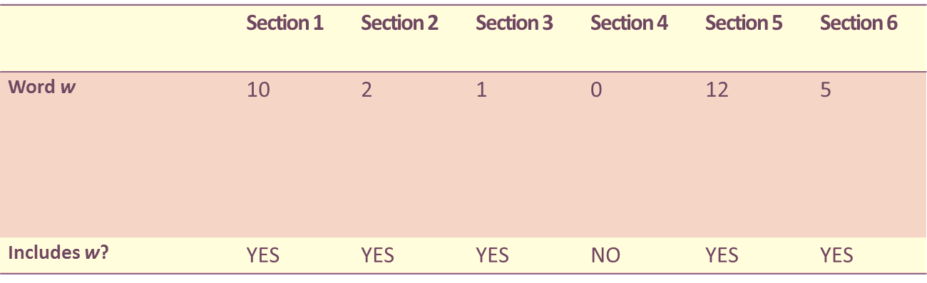

Measures of dispersion
$$=no. of parts with word w$$
a) Range
b) Standard deviation
c) Juilland’s D
Range(w) = 5

Slide 10
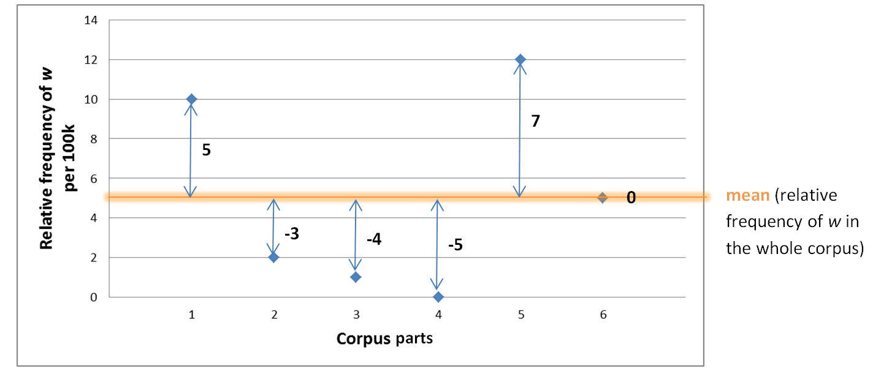

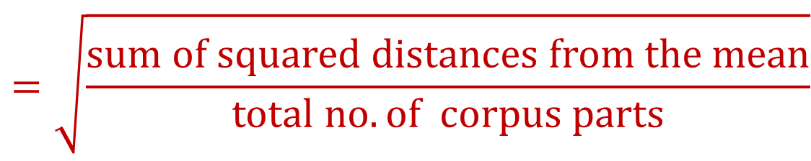
Measures of dispersion (cont.)
a) Range
b) Standard deviation
c) Juilland’s D
$$=\sqrt{\frac{sum of squared distances from the mean}{total no. of corpus parts}}$$

Slide 11

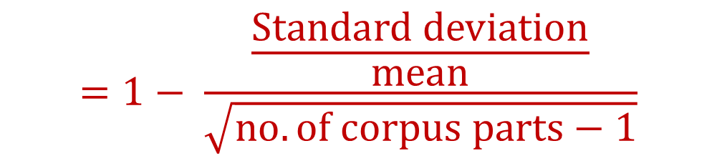
Measures of dispersion (cont.)
a) Range
b) Standard deviation
c) Juilland’s D
extremely uneven
distribution
perfectly even
distribution
0
observed variation
1
0.59
$$=1− \frac{\frac{Standard deviation}{mean}}{\sqrt{no. of corpus parts−1}}$$
max. possible variation

Slide 12
Measures of dispersion (cont.)
d) DP (Deviation of Proportions)
$$DP =\frac{\left.Sum of absolute values of (observed−expected prop.\right)}{2}$$

Slide 13

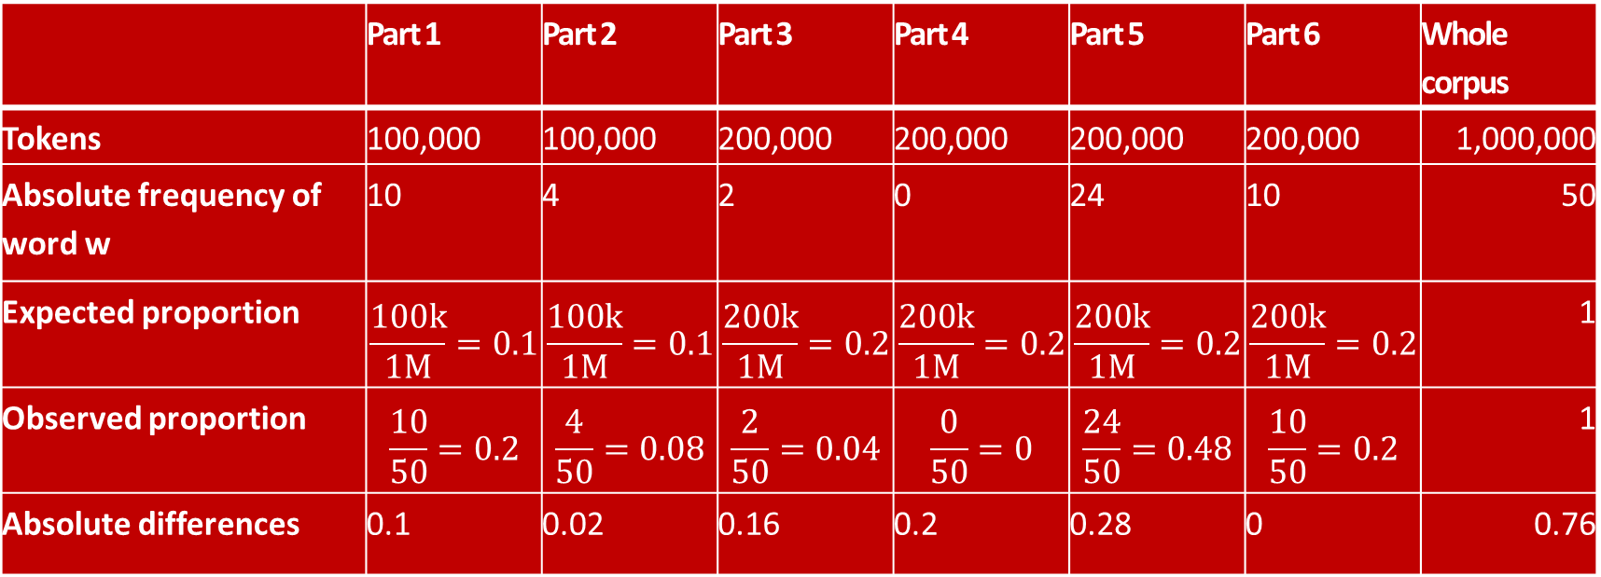
Measures of dispersion (cont.)
$$DP =\frac{0.76}{2}=0.38$$
d) DP (Deviation of Proportions)
 | Part 1 | Part 2 | Part 3 | Part 4 | Part 5 | Part 6 | Whole corpus
Tokens | 100,000 | 100,000 | 200,000 | 200,000 | 200,000 | 200,000 | 1,000,000
Absolute frequency of word w | 10 | 4 | 2 | 0 | 24 | 10 | 50
Expected proportion | $$\frac{100k}{1M}=0.1$$ | $$\frac{100k}{1M}=0.1$$ | $$\frac{200k}{1M}=0.2$$ | $$\frac{200k}{1M}=0.2$$ | $$\frac{200k}{1M}=0.2$$ | $$\frac{200k}{1M}=0.2$$ | 1
Observed proportion | $$\frac{10}{50}=0.2$$ | $$\frac{4}{50}=0.08$$ | $$\frac{2}{50}=0.04$$ | $$\frac{0}{50}=0$$ | $$\frac{24}{50}=0.48$$ | $$\frac{10}{50}=0.2$$ | 1
Absolute differences | 0.1 | 0.02 | 0.16 | 0.2 | 0.28 | 0 | 0.76
perfectly even
distribution
extremely uneven
distribution
0
1
0.38

Slide 14
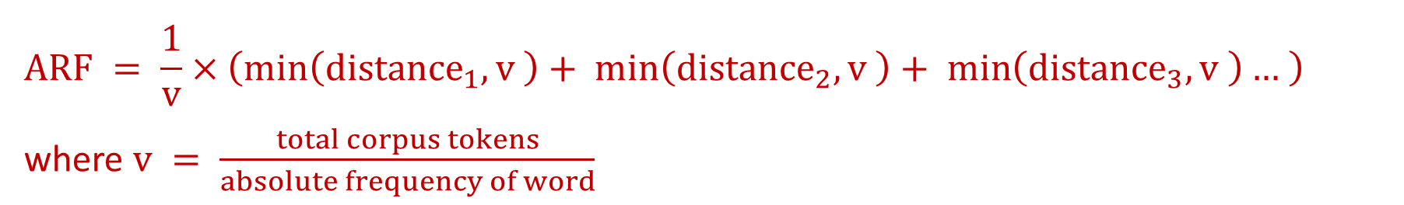
Average reduced frequency
$$ARF = \frac{1}{v}×\left(\min\left({distance}_{1}, v \right)+ \min\left({distance}_{2}, v \right)+ \min\left({distance}_{3}, v \right)… \right)$$
where $v = \frac{total corpus tokens}{absolute frequency of word}$

Slide 15
Average reduced frequency (cont.)
ARF = 1.000095
ARF = 4.999995
Absolute frequency = 5

Slide 16
Think about and discuss
Which of these two short texts is more lexically diverse?

Slide 17
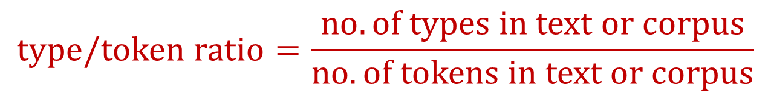
TTR, STTR and MATTR
Lexical diversity of texts.
$$type/token ratio=\frac{no. of types in text or corpus}{no. of tokens in text or corpus}$$

Slide 18
TTR, STTR and MATTR (cont.)
Small
TTR
………………………………………………………………………
window
window
window
window
window
Large

Slide 19
TTR, STTR and MATTR (cont.)
Small
TTR
window
Large

Slide 20
Things to remember
There are different concepts of a ‘word’ – token, type, lemma and lexeme.
Zipf’s law describes the distribution of words in corpora and their rapidly diminishing frequency.
To fully describe a word in a corpus we need to provide both the word’s frequency and its dispersion.
Different dispersion measures (Range, SD, CV, CV%, Juilland’s D, DP) are appropriate in different situations.
The average reduced frequency (ARF) is a measure that combines both frequency and dispersion; it can be used with corpora that are not divided into different parts (subcorpora).
TTR is a measure of lexical diversity; it is sensitive to text length.
STTR and MATTR are alternative measures of lexical diversity that can be used with texts of varying lengths.

