Slide 1
Introduction: Statistics meets corpus linguistics

Slide 2
What is statistics? Science, corpus linguistics and statistics

Slide 3
Think about and discuss
What is your personal experience with statistics (if any)?
Do you think statistics should be given a more prominent place at schools/universities?

Slide 4
What is statistics? Science, corpus linguistics and statistics
Statistics is a “science of collecting and interpreting data” (Diggle & Chetwynd 2011: vii).
Statistics is a discipline which helps us make sense of quantitative data (Brezina 2017 forth).

Slide 5
Generalising…
EXAMPLE 1: Use of adjectives by fiction writers
508, 542, 552, 553, 565, 567, 570, 599, 656, 695, 699
mean
591.45
median

Slide 6
Finding relationship…
EXAMPLE 2: Use of adjectives and verbs by fiction writers
508, | 542, | 552, | 553, | 565, | 567, | 570, | 599, | 656, | 695, | 699
2339, | 2089, | 2056, | 2276, | 2233, | 2056, | 2241, | 1995, | 2043, | 1976, | 2062

Slide 7
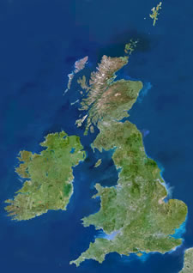
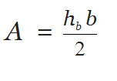

Building models…
Example 3: What’s the area of Great Britain?
$$=\frac{900×520}{2}$$
= 234,000 km²
900 km
520 km

Slide 8
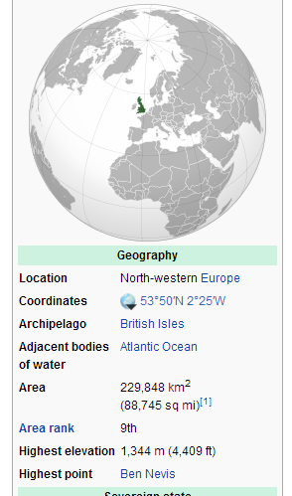
Building models…
Example 3: What’s the area of Great Britain?
$$=\frac{900×520}{2}$$
= 234,000 km²
900 km
Error: 4,152
520 km

Slide 9
Two things we can do with stats
data sets
dispersions
describe
infer
collocations
frequencies
graphs
statistical tests
95% confidence intervals
p-values
null hypotheses

Slide 10
Basic statistical terminology

Slide 11
Basic statistical terminology: review
assumption
case
confidence interval
dataset
dispersion
distribution
effect size
normal distribution
null-hypothesis
outlier
p-value
robust
rogue value
statistical measure
statistical test
standard deviation
variable

Slide 12
Statistical test
Hypothesis (e.g. Men and women use language differently.)
Null hypothesis: There is no difference between how men and women use language.
Corpus (male)
Corpus (female)
16
14
Is the difference due to chance or is it statistically significant?
Notes:
A scientific hypothesis is the initial building block in the scientific method. Many describe it as an “educated guess,” based on prior knowledge and observation, as to the cause of a particular phenomenon. It is a suggested solution for an unexplained occurrence that does not fit into current accepted scientific theory. A hypothesis is the inkling of an idea that can become a theory, which is the next step in the scientific method. A key function in this step in the scientific method is deriving predictions from the hypotheses about the results of future experiments, then performing those experiments to see whether they support the predictions.

Slide 13
Statistical test (cont.)
Null hypothesis
Statistical test
p-value
How much evidence do we have in the data to reject the null hypothesis?
reject the null hypothesis
< 0.05
> 0.05
The probability of seeing values at least as extreme as observed if the null hypothesis were true.

Slide 14
Building of corpora and research design

Slide 15
Think about and discuss
How many texts do we need to collect to create a corpus?
What does it mean to say that a corpus is representative?
Are large corpora always better than small corpora?

Slide 16
Corpus as a sample
Corpus

Slide 17
20B
500M
100M
1M

Slide 18
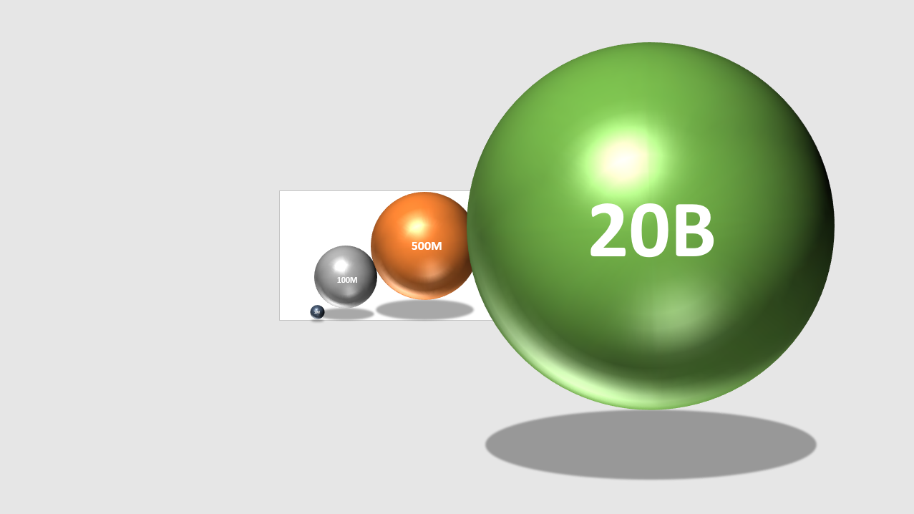

Slide 19
Corpus
Corpus
Representative? Unbiased?
Corpus
Corpus
Corpus

Slide 20

Corpus sampling
Corpus

Slide 21
Levels of analysis in corpus linguistics
Dimension | Key questions | Key terms
1) DATA EXPLORATION | What are the main tendencies in the data? | Graphs, means, SDs
2) INFERENTIAL STATISTICS: AMOUNT OF EVIDENCE | Do we have enough evidence to reject the null hypothesis? Is the effect that we see in the sample due to chance (sampling error) or does it reflect something true about the population? | statistically significant p-values confidence intervals
3) EFFECT SIZE | How large is the effect in the sample? (standardised measure) | effect size e.g. Cohen’s d, r
4) LINGUISTIC INTERPRETATION | Is the effect linguistically/socially meaningful?

Slide 22
Exploring data and data visualisation

Slide 23
Think about and discuss
Why is looking critically at data before analysis important?
What types of errors can we encounter in a dataset?
What types of graphs do you know?

Slide 24
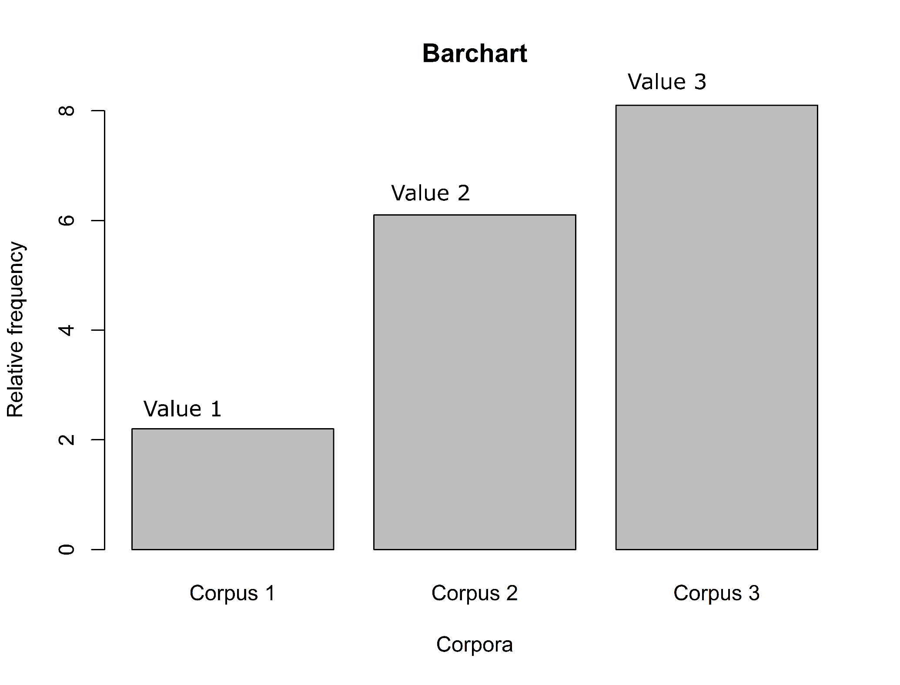
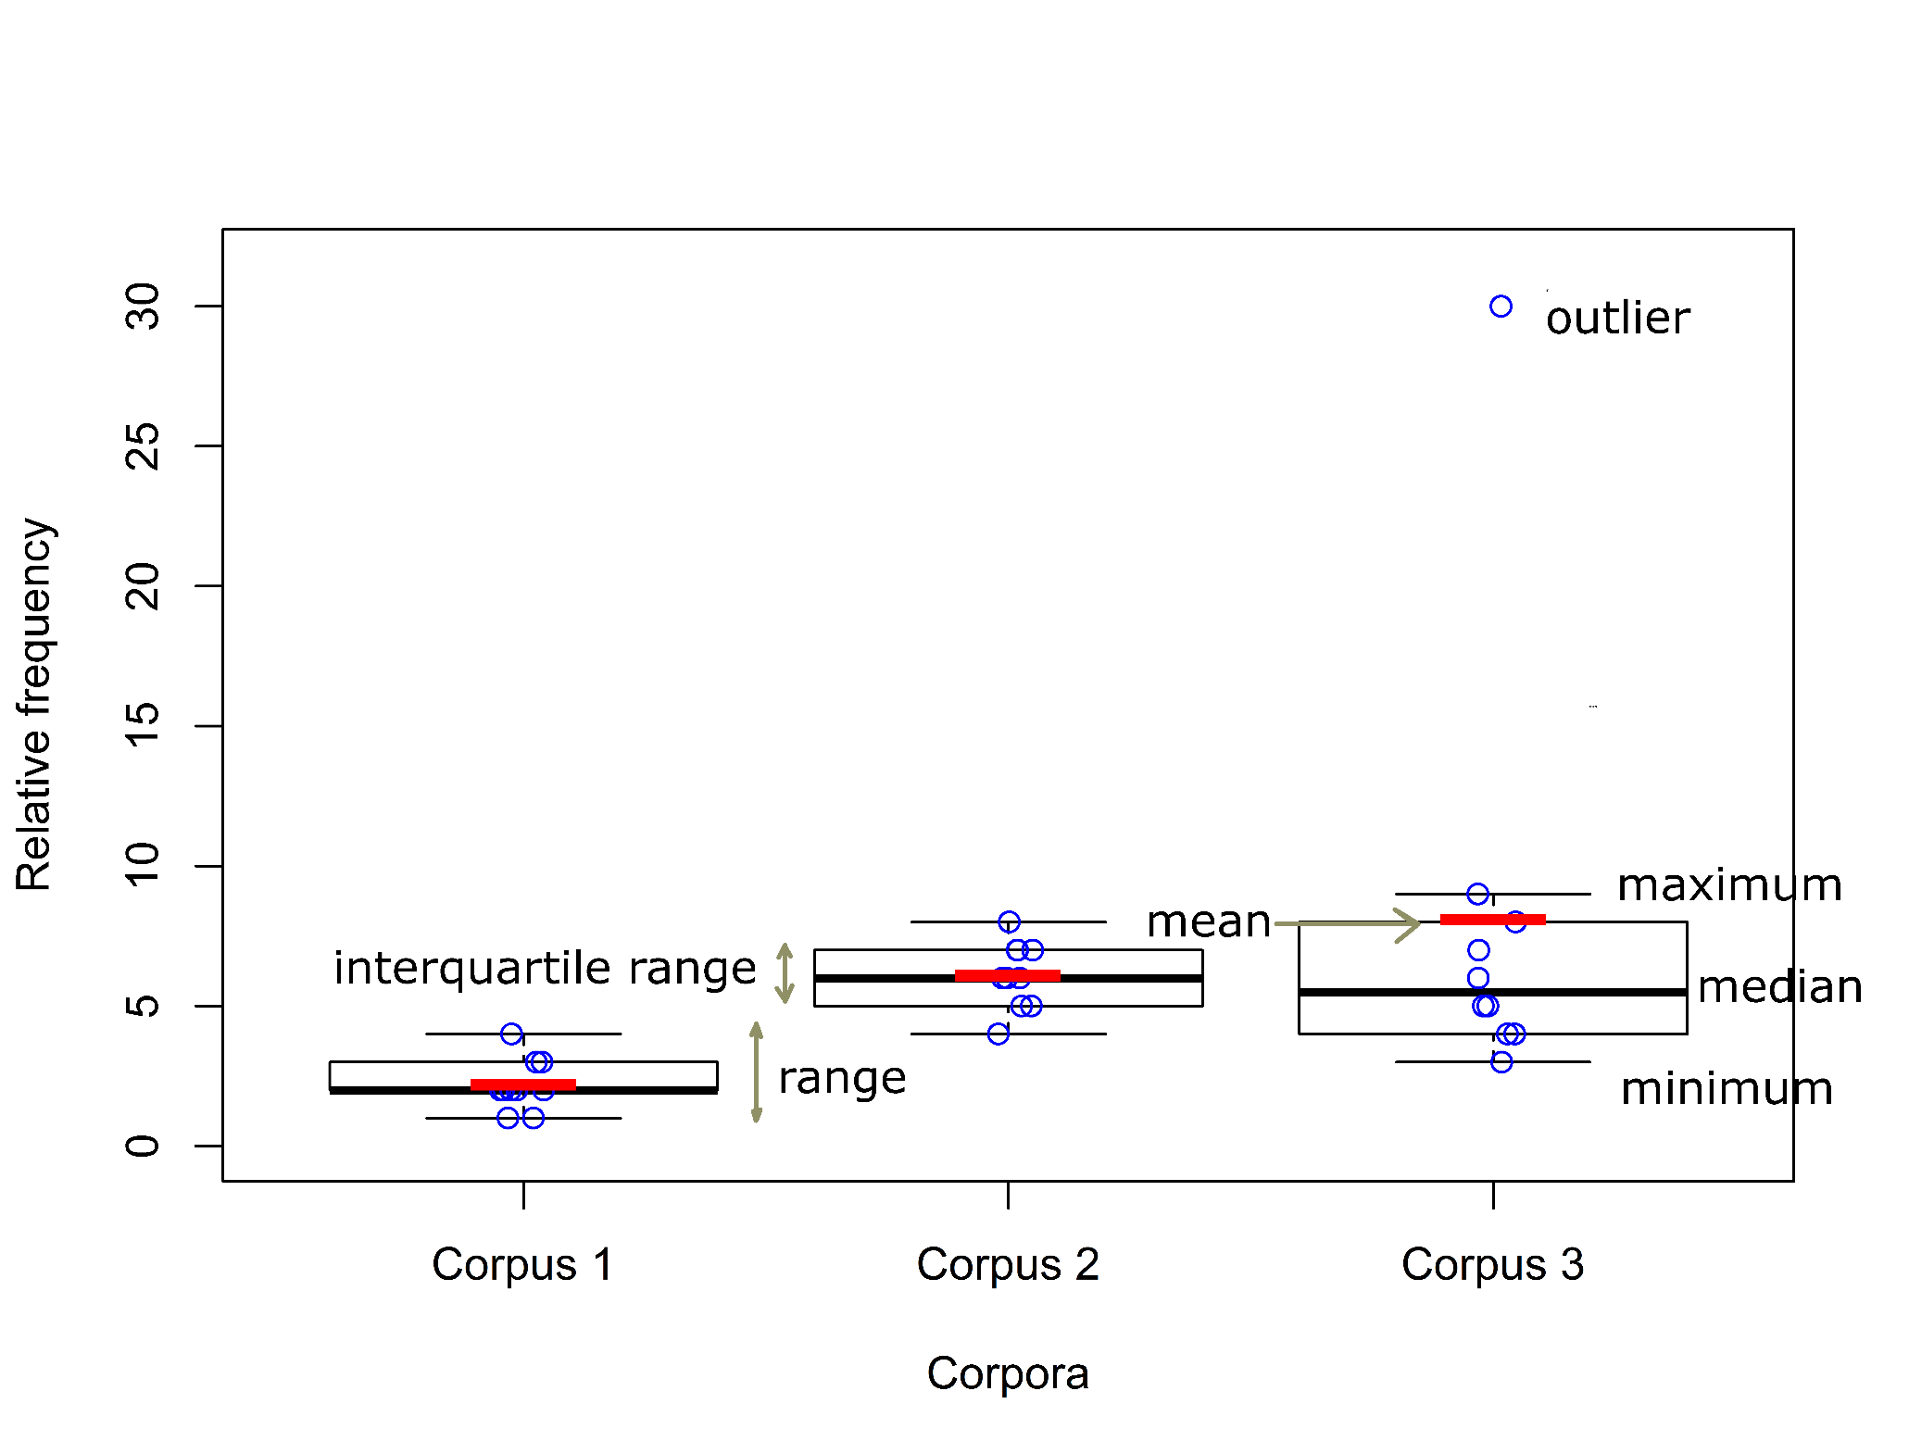
Exploring data and data visualisation

Slide 25
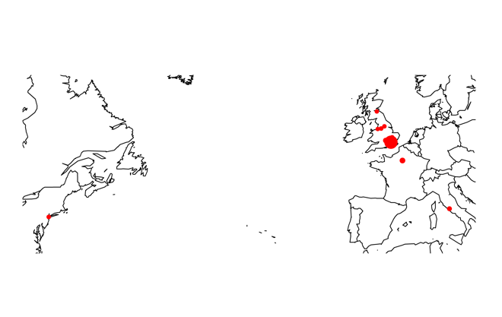
Exploring data and data visualisation

Slide 26
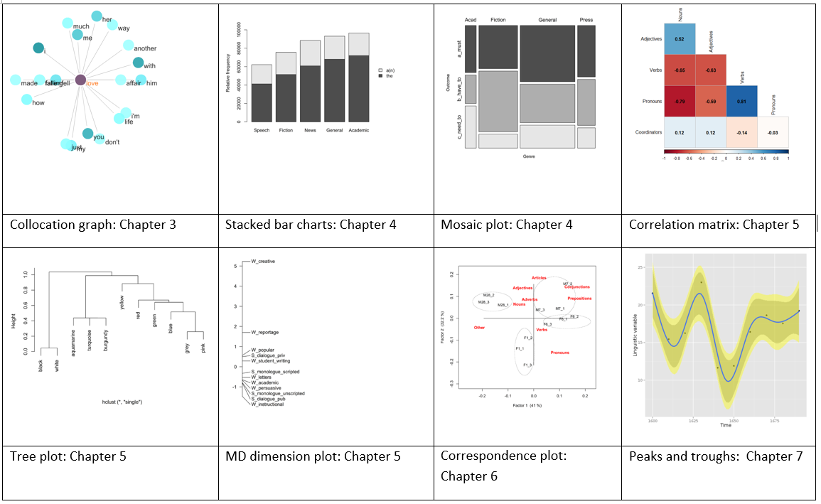
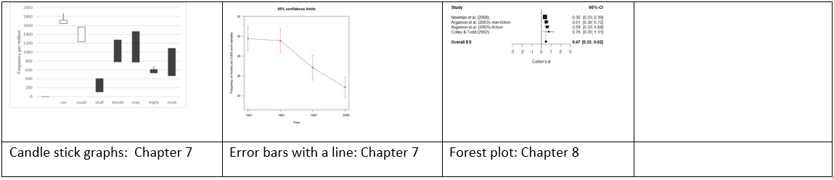

Slide 27
Things to remember
Corpus linguistics is a scientific method.
Successful application of statistical techniques in corpus linguistics depends on the use of a well-constructed unbiased corpus.
Statistics uses mathematical expressions to help us make sense of quantitative data.
Effective visualization summarizes patterns in data without hiding important features.
Although most visible, p-values form only a (small) part of statistics.
‘Statistical significance’, ‘practical importance’ and ‘linguistic meaningfulness’ are three separate dimensions which shouldn’t be confused.

